Slide 1
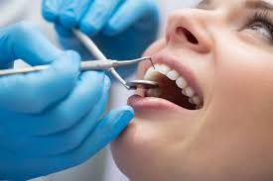
The West Virginia Oral Health Program
“Improving health, one smile at a time.”
Dr. Jason Roush, State Dental Director
West Virginia Oral Health Program
August 2019

Slide 2
Objectives
Discuss history of the oral health program in West Virginia;
Discuss current program initiatives;
Define/discuss the importance of collective impact on project success.

Slide 3
History of Oral Health Program in WV
1999 – Pre-Employment Project & Children’s Dental Health
2000 Project (Fluoride Mouth rinse and Water Testing)
2004 – Donated Denture Project
2010 – First full-time State Dental Director
First State Oral Health Plan (2010-2015)
2011 – DentaQuest funding for oral health surveillance & oral health epidemiologist
State oral health funds to provide regional oral health coordination and conduct surveillance (Marshall University School of Medicine)
Pre-K
3rd Grade
Adult
Older adult
Dental workforce

Slide 4
History of Oral Health Program in WV
2012 – First federal award – HRSA Dental Workforce (2012-2015)
2013 – Federal awards:
CDC Oral Disease Prevention Project (2013-2018)
HRSA PIOHQI Project (2013-2017)
2014 – First WV Oral Health Coalition Coordinator
First Burden of Oral Disease
2015 – Federal Award: HRSA Dental Workforce (2015-2018)
Second State Plan (2016-2020)
2016 – WV Oral Health Coalition established as 501(c)3
Potential federal award: CDC/Chronic Disease Collaborative (2016-2018)

Slide 5
Most Prevalent Dental Issues in WV
Oral disease experience in children:
More than 1 in 2 children (56%) enter school with a history of caries (cavity) experience.
One in five children (21%) have active, untreated decay upon school entry.
Recruitment and retention of dental workforce:
Over 1 in 3 dentists (37%) plan to retire in the next 10 years.
In 2011, WV retained only 6 members of the graduating class from WVU.
Lack of adult dental coverage:
Overutilization of emergency rooms for dental-related pain.
Use of pain killers for dental pain can lead to prescription substance abuse issues.
Burden on the healthcare system:
Free clinics
West Virginia University School of Dentistry
Federally-qualified health centers (FQHCs)
Dental care lacking for patients needing chronic disease management.

Slide 6
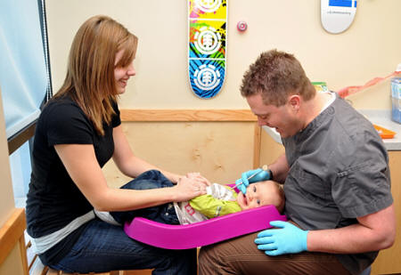
Perinatal & Children’s Initiatives

Slide 7
HRSA Perinatal & Infant Oral Health Quality Improvement (PIOHQI)
Pilot Project
WV is one of three states initially awarded in 2013 (currently over 15 states participating)
Completed first ever Perinatal Basic Screening Survey (BSS) in 2014
Project goals
Make oral health part of routine prenatal care
Age 1 dental visits
Establish dental home
“Pregnant women with gum disease have only a 1 in 7 chance of giving birth to a healthy child of normal size.”
-American Academy of Oral Systemic Health

Slide 8
What is OHP doing for perinatal oral health?
History
Emergency-only benefit for Medicaid-eligible adults in WV (age 21 and above)
WV has 4 managed care organizations (MCOs)
MCOs provide value adds (incentives) to eligible members, but they are not the same across the board
MCOs providing dental service value add for pregnant members
Pilot Question
Would OB/GYN providers promote and eligible pregnant members utilize dental value adds if incentivized to do so?
Notes:
Unicare
Aetna
WVFH
The Health Plan
As of June 30, 2019. WVFH went away.

Slide 9
How It Turned Out
Contracting with MCOs to incentivize value add for OB/GYN providers and eligible-pregnant members
MCOs were to provide quarterly updates to project on utilization of eligible members
Project end date- September 2018 (PIOHQI)
Target population | Potential Impact | Incentive
OB/GYN Providers | 214 (2016 WV) Pilot target = 40 max | $25/member with completed dental visit
Eligible pregnant members | ≈6,000 annually | $25/visit (up to 2 through 60 days postpartum)
Notes:
Issues with getting the MCOs registered.
WVFH reported that 33 women utilized the incentive during the third quarter.

Slide 10
Guidance for Prenatal Care Health Professionals
Work in Collaboration with
Oral Health Professionals
Establish relationships with oral health professionals in the community
Develop a formal referral process
Share pertinent information about pregnant women
Coordinate care
Photograph is copyrighted and may not be reproduced.
Notes:
Prenatal care health professionals can work in collaboration with oral health professionals by establishing relationships with oral health professionals in the community, developing a formal referral process, sharing pertinent information about pregnant women, and coordinating care.

Slide 11
What is “Early Childhood Caries” (ECC)?
Notes:
In the next few slides we are going to briefly review early childhood caries and the signs and symptoms associated with this preventable disease.

Slide 12
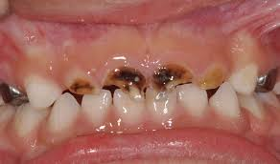
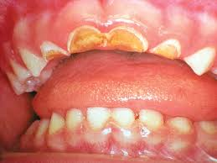
Early Childhood Caries (ECC)
An infectious, chronic disease that destroys tooth structure
ECC affects 35% of 3-year-olds from low income families
Notes:
What is Early Childhood Caries? An Infectious chronic disease that destroys tooth structure leading to loss of chewing function, pain and infection. Usually caused by poor eating habits and a lack of good oral hygiene habits. A variety of eating habits are implicated. Those habits include constant snacking and use of a bottle or sippy cup containing sugary drinks. ECC affects 35% of 3 year olds from low income families. Early childhood caries affects the teeth that emerge early and are least protected by saliva. The order of progression starts with the maxillary anterior teeth, the first molars, then on to the second molars.

Slide 13
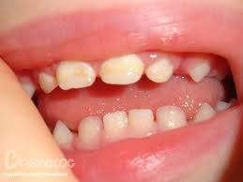
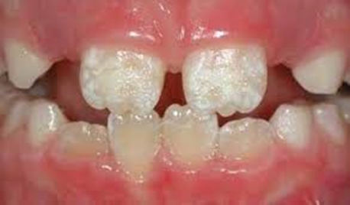
Enamel Defects
20 to 40% of children have enamel defects
These defects can appear as changes in color or texture
Notes:
Enamel defect is a developmental dental defect – not caused by habits or poor oral hygiene. which can be implicated as "weak" or "chalky" enamel with reduced thickness or enamel with poor quality. These defects appear as chalky spots or creamy yellow or brown or white patches on a child's teeth. Some of these factors include:
Mother's health during pregnancy (illnesses, diet deficiency)
Prematurity
Birth difficulties
Medications given to mother during pregnancy or to child during early childhood
Early childhood diseases (high fever, pneumonia, middle ear infection, viral infections etc.)
Chronic / frequent childhood illness during first four years of life
Poor childhood nutrition
Fluoride treatments, restorations (fillings or crowns) or extractions of very badly formed teeth along with orthodontic treatment are the treatment options for enamel defects.

Slide 14
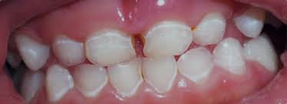
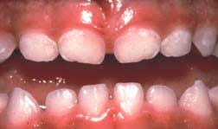
White Spots – Mild ECC
White spots, (Decalcification) usually at the gingival margin, are the first signs of demineralized enamel
Caused by food sitting at gumline on the surface of the tooth for too long
If not managed, these spots can progress to cavities
Notes:
White spots and lines at the gingival margin (gum line) are the first clinical signs of demineralized enamel. If this disease process is not managed, these white spots will progress to cavities. The treatment options for the white spots are immediate referral to a dentist, comprehensive dietary counseling along with oral hygiene education/instruction, and topical fluoride varnish to reverse or arrest lesions.

Slide 15
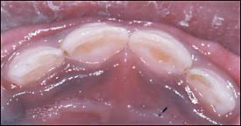
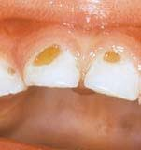
Moderate ECC: Brown Lesions
Enamel destruction exposing dentin
These lesions darken as they become stained from food
Notes:
During moderate early childhood caries the enamel destruction has exposed the underlying dentin. Dentin is softer and more cavity prone than enamel. These lesions darken as they become stained with pigments from food. If these lesions are not treated, the carious bacteria will begin to spread throughout the mouth causing rampant generalized decay.

Slide 16
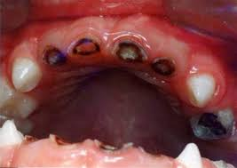
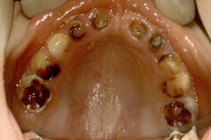
Severe ECC
Multiple dark cavities visible (anterior and posterior)
Abscess or draining fistulae often present
Notes:
During severe early childhood caries there are multiple dark cavities visible. These cavities appear in the anterior and posterior teeth. There may be an abscess or draining fistulae present, which is typically seen on the gum. Patients often experience pain, but young children may not be able to verbalize this other than mentioning a bad taste or smell from their mouth.

Slide 17
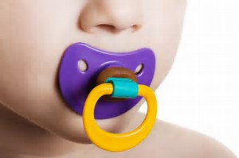
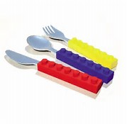
How can I help prevent ECCs?
Health care providers can educate parents to:
Visit the dentist regularly – parents and baby (by age 1); need to be seen twice per year
Practice good oral hygiene – Parents brushing for child (with fluoride toothpaste), flossing, eating healthy snacks;
Do not clean the baby’s pacifier with mouth;
Do not share toothbrushes, cups, utensils.
Avoid bottles/sippy cups throughout day or to bed (Frequency)
Notes:
Oral health doesn’t just affect your teeth and gums. It also affects the health of your entire body. On-going dental problems can significantly impact your quality of life. Dental problems can interfere with how you talk, eat and drink. Poor oral health can lead to cardiovascular and respiratory problems as well as diabetes issues just to name a few. Oral health education is an important topic to discuss with parents or guardians. Primary care providers can educate parents about regular dental visits, not only for the child, but the parents as well. This is the time for a dental home to be established if the parent/guardian has not already done so. A dental home is the ongoing relationship between the dentist and the patient, inclusive of all aspects of oral health care delivered in a comprehensive, continuously accessible, coordinated, and family-centered way. Discuss the importance of the age one dental visit and what to expect. The age one dental visit is a great opportunity to introduce the baby to good oral habits early on and set the stage for dental visits being included as a normal lifelong procedure. Education to the parents about proper brushing and flossing as well as healthy eating habits. This is also a great opportunity to discuss the importance of not cleaning the baby’s pacifier with their mouth as this spreads bacteria from parent to baby. Also discuss how you should never share toothbrushes, cups or utensils with your child or let your children share with one another. Many people do not realize how this spreads bacteria.

Slide 18
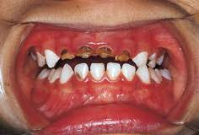
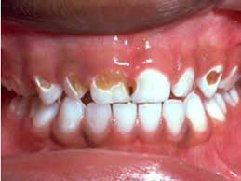
How can I help manage ECCs?
Dietary and oral hygiene counseling
Fluoride varnish application
Referral for to dental home for comprehensive dental treatment
Notes:
As mentioned in previous slides, the treatment options for early childhood caries will include comprehensive dietary counseling as well as oral hygiene instruction to the parents/guardian as well as the child . Fluoride varnish may be used to arrest cavity lesions and prevent development of new cavities or “spots”. Urgent dental referral for comprehensive treatment may be needed for moderate to severe caries cases. This may include procedures such as extractions, fillings or root canals and/or all under general anesthesia.

Slide 19
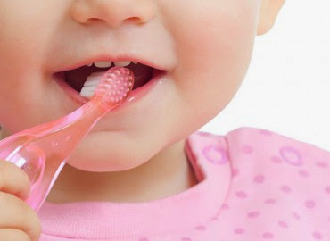
Fluoride Varnish Training Program
Designed to educate primary care providers and their staff on:
Caries risk assessment;
Fluoride varnish application;
Facilitation of the age
one dental visit.
Target population:
Children ages 6 months to 36 months who are at high risk for developing dental caries

Slide 20
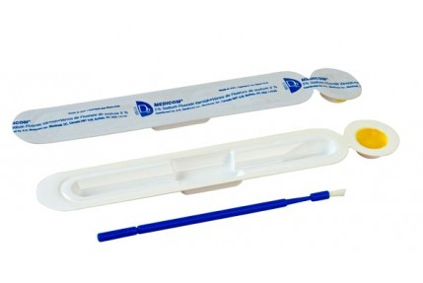
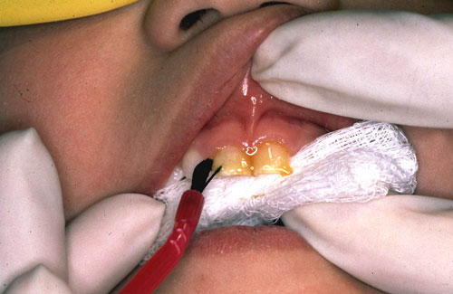
Fluoride Varnish Training Program
Initiated by WV CHIP (Children’s Health Insurance Program) to reduce rates of early childhood caries in at-risk WV children
Administered through Oral Health Program (formerly West Virginia University)

Slide 21
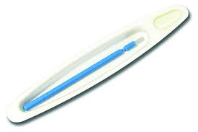
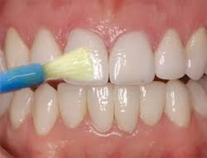
What is Fluoride Varnish?
A highly concentrated form of fluoride which is applied to the tooth's surface
Applied by a dentist, dental hygienist or other health care professional
A type of topical fluoride therapy.
Notes:
Fluoride varnish is a highly concentrated form of fluoride which is “painted” onto the teeth with a soft brush. This can be applied by a dentist, dental hygienist or other health care professional. Fluoride varnish can be applied up to 4 times per year (The recommendation is two from a dental professional and two from a primary care professional). It is easy to apply and sets quickly. Varnish comes in many flavors as this makes it more appealing, especially to children. Although fluoride varnish is available in several colors, most providers offer the tooth colored option to make it more attractive and harder to detect on the teeth.

Slide 22
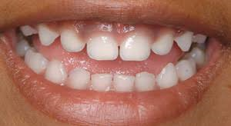
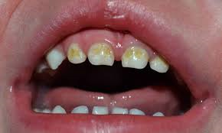
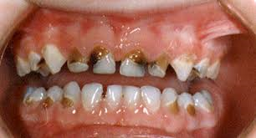
Why is Fluoride Varnish Important?
Tooth decay (dental caries) is the leading chronic infectious disease for children in the United States (CDC);
In WV, 34% of preschoolers already have dental caries (2014 WV Oral Health Surveillance);
Studies have shown a 25-45% reduction in decay rate with the use of fluoride varnish.
Notes:
Although largely preventable, tooth decay is the single most common chronic childhood disease. It is 5 times more common than asthma, 4 times more common than early- childhood obesity, and 20 times more common than diabetes. More than one third of preschoolers in West Virginia already have dental caries. Fluoride varnish works to help prevent tooth decay, slow it down, or stop it from getting worse. In the past, efforts to prevent dental caries focused mainly on proper brushing and flossing and good dietary practices. Studies have shown a 25-45% reduction in decay rate with the use of fluoride varnish.

Slide 23
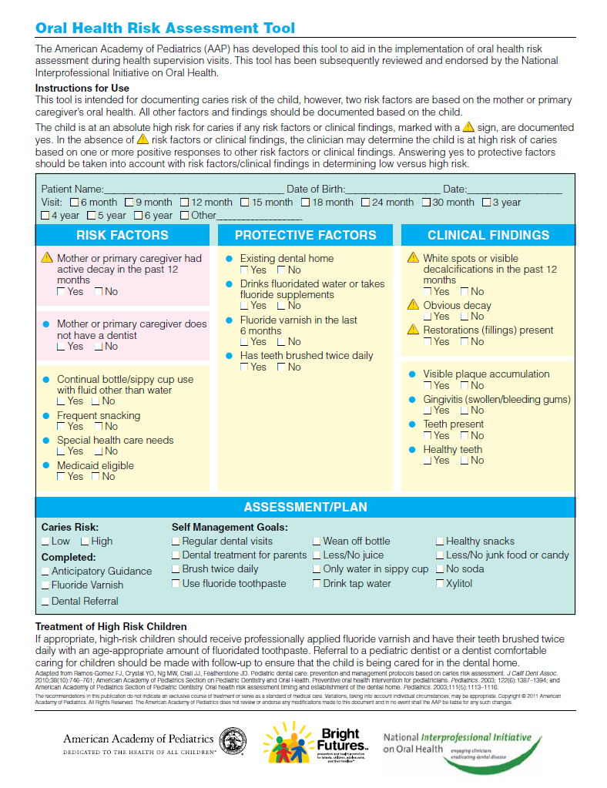
Target Population for Fluoride Varnish
Target Population for Healthcare Providers
Children ages 0 through 6, especially those at high-risk for dental caries.
Risk level determined by completion of a caries risk assessment.
Notes:
The American Academy of Pediatrics (AAP) has developed the Caries Risk Assessment Tool to aid in implementation of oral health risk assessment during well child visits. The Bright Futures/AAP “Recommendations for Preventive Pediatric Health Care” recommends all children receive a risk assessment at the 6 and 9 month visits. For the 12, 18, 24 and 30 month and 3 and 6 year visits, risk assessment should continue if a dental home has not been established. If appropriate, high-risk children should receive professionally applied fluoride varnish and have their teeth brushed twice daily with an age appropriate amount of fluoridated toothpaste. Referral to a pediatric dentist or a dentist comfortable caring for children should be made with follow-up to ensure that the child is being cared for in the dental home. You can find this handout on the Smiles for Life website.

Slide 24
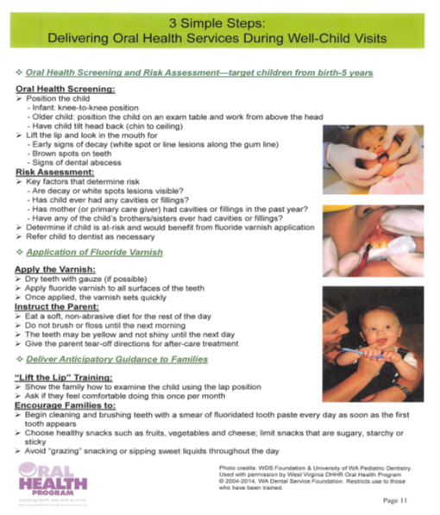
Three Simple Steps
Oral Health Screening with Caries Risk Assessment
Application of Fluoride Varnish
Deliver Anticipatory Guidance to Families
Notes:
Delivering oral health services during a well child visit can be done in three simple steps. Oral health screening and risk assessment, application of fluoride varnish and deliver anticipatory guidance to families. This handout can be found on the smiles for life website.

Slide 25
Oral Health Screening and Caries Risk Assessment
Lift the lip and look in the mouth for
- Signs of decay (white spots)
- Brown spots
- Abscess
Key factors:
- Are decay or white spots visible?
- Has the child ever had any cavities or fillings?
- Have any of the siblings had cavities or fillings?
- Has the mother/primary care giver had cavities or fillings in the past year?
Determine if the child is at risk or would benefit from fluoride varnish
Refer the child to a dentist as necessary
Notes:
Lift the lip and look for signs of abnormalities. Key factors to determine during the oral health screening and risk assessment include- are any white spots or decay visible? Has the child ever had cavities or fillings? Have any siblings had cavities or fillings? Has the mother or primary care giver had cavities or fillings in the past year? Determine if the child is at risk and would benefit from a fluoride varnish application. Refer the child to the dentist as necessary. Ask if they have a dental home and when the last dental visit took place. This is also the opportunity for oral health education. If plaque is present, show the parent and discuss brushing and flossing techniques. The child may cry during the exam. If the child does not open their mouth, slide your finger in buccal sulcus and apply gentle pressure.

Slide 26
Updates
WV Medicaid expanded reimbursement for primary care (non-dental) fluoride varnish application for eligible children ages 0 through 20 years.
WVCHIP expanded reimbursement for eligible children ages 6 months to 18 years.
Primary care provider code opened to allow for reliable reimbursement of services (99188; formerly CDT 1206).
Eligible children can receive up to 4 applications of fluoride varnish annually (2 from a dental provider; 2 from a non-dental provider).
Notes:
Updates as of December 1, 2016. As many of you know, a non-dental code was opened for primary care providers to allow for a reliable reimbursement of services. This is for Medicaid eligible patients. The code, 99188, reimburses for children ages 0 through 20 years of age. This used to be through age 5. Eligible children can receive up to four applications of fluoride varnish annually ( 2 from a dental provider and 2 from a non-dental provider). WVCHIP opened the code January 1, 2019.

Slide 27
Updates
One of two applications is recommended to take place in conjunction with the annual well-child visit (EPSDT).
Training via the Smiles for Life Curriculum, specifically Course 6: Caries Risk Assessment, Fluoride Varnish and Counseling is recommended, but not required for reimbursement of services.
All updates improve alignment with
recommendations/guidelines from:
Notes:
One of the two applications is recommended to take place with the annual well child visit. Although not required, training through the Smiles for Life, course 6: Caries Risk Assessment, fluoride varnish and counseling is recommended. All updates improve alignment with recommendations/ guidelines from American Academy of Pediatrics, Bright Futures and U.S Preventive Services Task Force.

Slide 28
Medicaid
Notes:
Here you will see the medical and dental provider codes for fluoride varnish. Again, this is for Medicaid eligible children under the age of 21. This gives a short description of each code. If anyone would like a copy of this, please email me and I can send you a copy.

Slide 29
WVCHIP
Effective January 1, 2019 the West Virginia Children’s Health Insurance Program (WVCHIP) will start reimbursing primary care providers for the application of fluoride varnish for children ages six (6) months to 18 years who are at high risk of developing dental caries.
Medical Providers
Code | Description
CPT: 99188 Diagnosis: Z41.8 | Patient must be under 19 years of age Limit 2 applications per year per patient Code can only be billed once within a 6-month period One fluoride varnish treatment should be applied at the time of a well-child visit or health screening
Dental Providers
Code | Description
ADA: D1206 | Patient must be under 19 years of age Limit 2 applications per year per patient Code can only be billed once within a 6-month period Service must be provided at a dental visit D1206 cannot be billed with D1208
Notes:
With OHP’s PIOHQI work.

Slide 30
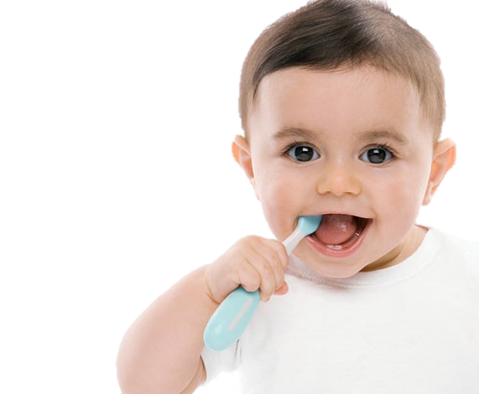
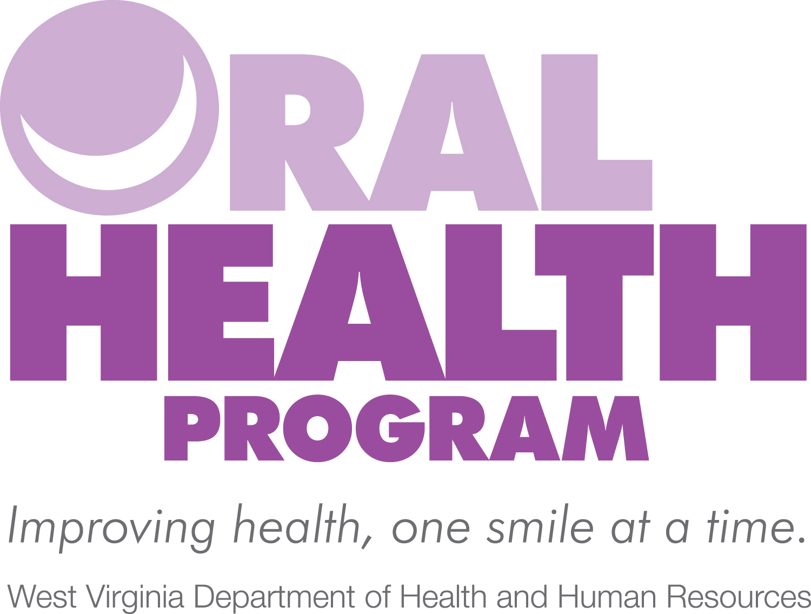
How can I participate?
Complete the Smiles for Life Curriculum “Course 6: Carries Risk Assessment, Fluoride Varnish & Counseling”
(FREE! – http://smilesforlifeoralhealth.org) - optional
Conduct caries risk assessment;
Provide fluoride varnish application to patients;
Refer children for age one dental visits!
1st Tooth
OR
1st Birthday
= 1st Dental Visit
Notes:
If you are wondering how you can participate, you can begin by completing the smiles for life curriculum, course 6. The course is optional, and will not only give you one hour of free CE, but will be very beneficial as it contains the helpful tools that have been presented throughout this webinar. The next step is to begin conducting the caries risk assessment and provide fluoride varnish to patients. Please do not forget to refer children for age one dental visits.

Slide 31
Preventing Oral Disease in Children
The Guide to Community Preventive Services recommends the following interventions to address tooth decay:
Community water fluoridation (CWF)
Evidence shows the prevalence of caries is substantially lower in communities with CWF. In addition, there is no evidence that CWF results in severe dental fluorosis.
School-based dental sealant delivery programs
These programs increase the number of children who receive sealants at school and result in a large reduction in tooth decay among school-aged children (5 to 16 years of age).
Source: The Guide to Community Preventive Services

Slide 32
National Children’s Oral Health Data
More time is lost when students miss school because of toothaches. An estimated 51 million school hours per year
are lost due to dental related illness.
Vs.
Overall, children with good oral health spend
more time in school learning.

Slide 33
EPSDT
Source: West Virginia CMS-416: Annual Report – FY 2012 through FY 2015
Percentage of EPSDT-Eligibles Receiving Preventive Dental Services by Age and Fiscal Year (FY)
Age | FY 2012 | FY 2013 | FY 2014 | FY 2015 | FY 2016 | FY 2017
<1 | 0.8% | 1.0% | 0.9% | 1.1% | 2.6% | 0.2%
1-2 Years | 15.6% | 16.2% | 15.7% | 18.9% | 25.3% | 11%
3-5 Years | 50.8% | 52.0% | 53.8% | 58.6% | 67% | 50%
6-9 Years | 54.3% | 55.1% | 54.7% | 62.3% | 70% | 60%
10-14 Years | 49.0% | 51.1% | 50.5% | 54.5% | 63% | 55%
15-18 Years | 39.4% | 41.3% | 39.6% | 43.4% | 53% | 44%
19-20 Years | 9.4% | 9.5% | 8.6% | 15.8% | 24% | 22%
Overall Annual Average | 39.5% | 40.8% | 41.0% | 44.9% | 54% | 43%
Source: West Virginia CMS-416: Annual Report – FY 2012 through FY 2017
Notes:
In a review of the West Virginia Centers for Medicare & Medicaid Services (CMS) 416: Annual Early and Periodic Screening, Diagnosis and Treatment (EPSDT) Participation Reports from the last available six fiscal years (2012-2017), the average utilization for preventive dental care for children aged 0 to 20 years is 43.8%. The table shows the breakdown of utilization for preventive dental care by age group, as well as the overall annual average. Addressing the needs of cyschn in West Virginia, especially in our youngest populations brings a new and evolving dynamic in light of the opioid epidemic and support for MCH populations and their communities.

Slide 34
West Virginia Substance Abuse Trends – Select Indicators
Source: 2018 OMCFH Title V Block Grant Application
Notes:
the number of West Virginia children entering foster care (particularly those aged 0 to 35 months old), those identified with neonatal abstinence syndrome (NAS) at birth and those being referred for Birth to Three (BTT) services has increased proportionately as the number of opioid deaths have increased. Children in foster care are now categorically eligible for care coordination services from our state Children with Special Health Care Needs (CSHCN) Program, as they are considered to be CYSHCN.
According to the National Survey of Children with Special Health Care Needs (NS-CSHCN), last completed in 2009-2010, there were an estimated 70,609 children and youth with special health care needs in West Virginia and the prevalence of cyschn continues to be one of the highest in the country. More recent data from the 2016 NS-CH estimates the number of CYSHCN to be nearly 1 in 4 (24.1%; approximately 91,000) West Virginia children, which continues to exceed the national rate of 19.4%.
The burden of CYSHCN in West Virginia is compounded by the fact that the state has a high rate of children living in poverty and has the third highest prevalence of CYSHCN in the country behind only Kentucky and Mississippi. As seen nationally, the prevalence of CYSHCN in West Virginia decreases with income level, increases with age and is more prevalent among males than females. A higher proportion of CYSHCN in West Virginia meet the Maternal, Child and Health Bureau core outcomes than the United States as a whole, but there is definite room for improvement.

Slide 35
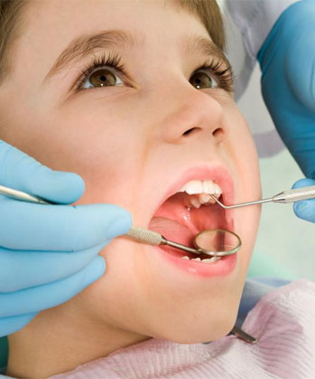
CDC Oral Disease Prevention Project (ODPP)
Goal is to increase the number of public school students with sealants (evidence-based prevention);
WVBE Policy 2423 – Health Promotion and Disease Prevention: partnership with WVDE and OHP

Slide 36
WV Board of Education Policy 2423
§126-51-5. Health Promotion through School Screenings/Examinations.
Section 5.3. Oral Health: New enterers in West Virginia public school Pre-K and Kindergarten and students progressing to grades 2, 7 and 12 should have on file within 45 days of entry or prior to the first day of school attendance a record of an oral health examination. The following transition plan will request each new enterer in Pre-K and Kindergarten and grades 2, 7 and 12 to show proof of an oral health examination beginning the school year (SY) 2015/16 all new enterers in Pre-K and Kindergarten; beginning SY 2016/17 all students entering grade 2; beginning SY 2017/18 all students entering grade 7; and beginning SY 2018/19 all students entering grade 12. All examination forms shall be signed and dated by the student’s dentist and completed within the prior 12 calendar months. If the student does not have proof of an oral health examination during the grade of requirement, the student may be enrolled into the WVDHHR-Oral Health Program (OHP) Oral Disease Prevention Project. The Oral Health Prevention Project will provide an oral health assessment from a dental provider regardless of the ability to pay if the parent/guardian provides approval/consent for the student to participate.

Slide 37
WV Board of Education Policy 2423
Dental Examination Phase-in Plan:
2014-15: Communication & tracking development
2015-16: Pre-K and K
2016-17: Pre-K , K and grade 2
2017-18: Pre-K, K, grades 2 and 7
2018-19: Pre-K, K and grades 2, 7 and 12

Slide 38
WV Board of Education Policy 2423
§126-51.7. Quality assurance for school-based services.
Section 7.1. All community services performed in the school setting should be regular and on-going services that are evidence-based or a promising practice and follow best practices and guidelines. The terms regular and on-going services as referenced refer to community services that are provided within the school in an agreed upon manner between the school and community partner(s) which work toward promoting both the academic, health and social service needs of students.
Section 7.1.C. Oral health services shall incorporate the protocols set forth by the WVDHHR-OHP.

Slide 39
WV Oral Health Survey 2017-2018
37 Schools
Third Grade
1,192 students received a dental screening
48% response rate
(1,192 of the 2,495 3rd grade enrolled in the participating schools)
Notes:
With implicit stratification by health region (4 regions), a systematic probability proportional to size sampling scheme was used to select a sample of 37 schools. If a school refused to participate, a replacement school was randomly selected from the same sampling interval.

Slide 40
Results
Related Healthy People 2020 Objective
OH-1.2: Reduce the proportion of children aged 6-9 years who have dental caries experience in their primary or permanent teeth
Baseline: 54.4% of children aged 6 to 9 years had dental caries experience in at least one primary or permanent tooth in 1999–2004
48.3% Decay Experience
Notes:
Decay experience: Refers to having untreated decay or a dental filling, crown, or other type of restorative dental material. Also includes teeth that were extracted because of tooth decay.

Slide 41
Results
Related Healthy People 2020 Objective
OH-2.2: Reduce the proportion of children aged 6-9 years with untreated dental decay
Baseline: 28.8% of children aged 6 to 9 years had untreated dental decay in at least one primary or permanent tooth in 1999–2004
18.7% Untreated decay
Notes:
Untreated decay: Dental cavities or tooth decay that have not received appropriate treatment

Slide 42
Results
Related Healthy People 2020 Objective
OH-12.2: Increase the proportion of children aged 6 to 9 years who have received dental sealants on one or more of their permanent first molar teeth
• Baseline: 25.5% of children aged 6 to 9 years received dental sealants on one or more of their first permanent molars in 1999–2004
28.3% Dental Sealants
Notes:
Dental sealants: Plastic-like coatings that are applied to the chewing surfaces of back teeth. The applied sealant resin bonds into the grooves of teeth to form a protective physical barrier.

Slide 43
Results
Related Healthy People 2020 Objective
None
18.5% Need Dental Care
2% Need Urgent Dental Care
Notes:
Early or urgent dental care: Child needs to see a dentist within the next few weeks for dental care.
Urgent dental care: Child had pain or infection at the time of the screening

Slide 44
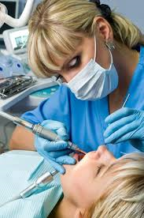
Workforce

Slide 45
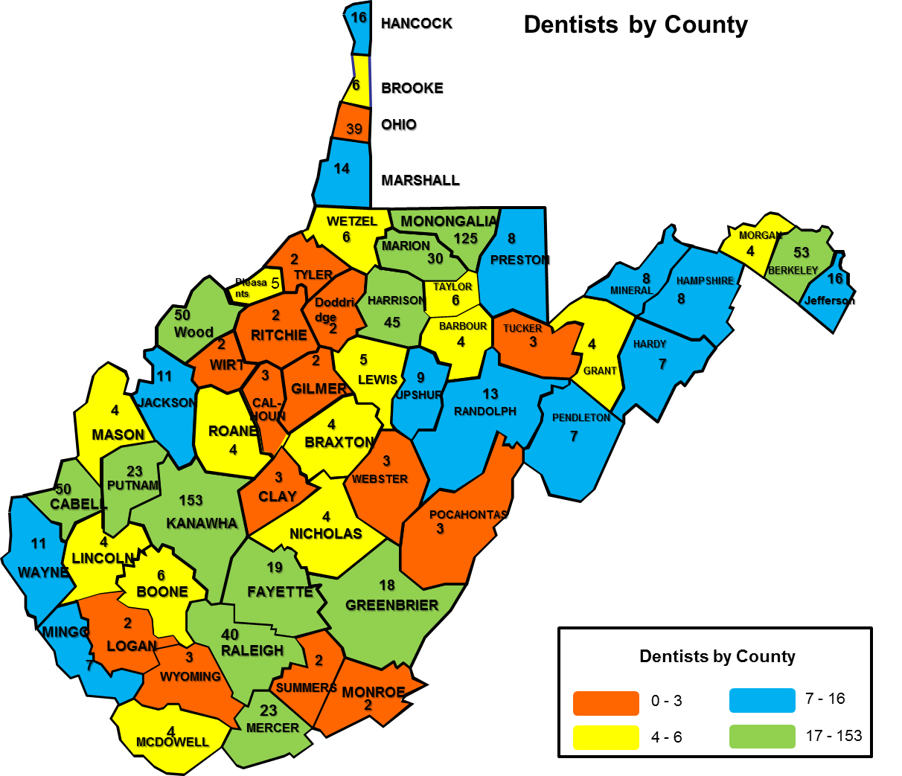
Dentists by County
Notes:
Currently, 1,392 dentists in WV

Slide 46
Dental Hygienists by County
Notes:
Currently WV has 1,576 RDH

Slide 47
Workforce
WVU Dental Graduates: 81.6% of DDS in WV are WVU graduates
2019 class:
47 Graduates
16 Associates in practices throughout WV
21 Residency Programs
(18 plan to return to WV)
6 Associates out of state
1 Military
1 Kuwait
1 NHSC
1 Undecided
Notes:
53%

Slide 48
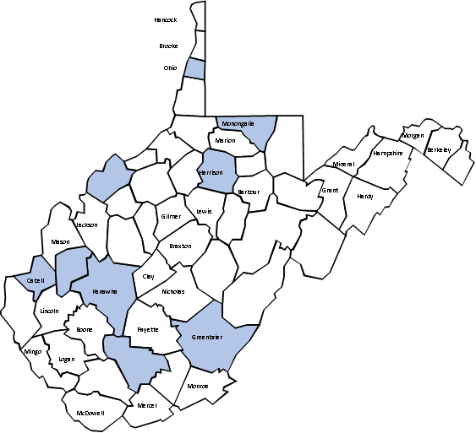
Pediatric Dentists
17 Board-certified pediatric dentists in WV
15 Currently practicing in WV
WVU is initiating a pediatric residency program
Notes:
The OHP is working to assist the dental school in the pediatric residency program.

Slide 49
HRSA Dental Workforce Grant (2015-2018)
Grants and/or low-interest loans for improving access in dental health professional shortage areas (dHPSAs)
Dental loan reimbursement
Division of Rural Health and Recruitment
Higher Education Policy Commission
Medical & Dental Collaboration
Fluoride varnish
Hygienists in non-traditional settings (i.e. OB/GYN sites)
Technical Assistance (TA) Team

Slide 50
Grant Overview
WV OHP received HRSA funding through a competitive grant process
Awarded approximately 1.5 million dollars
3 year project
A portion of the funding was used to address dental graduate retention in effort to improve access to care in Dental Health Professional Shortage Areas (DHPSA)
Funding was also used to provide technical support for dentists located in isolated areas via a technical assistance team

Slide 51
HRSA Dental Workforce
Awards ranging from $8,000 to $40,000 depending on specific need
The grant was awarded to expand services through equipment purchases/upgrades
Applicant must accept Medicaid and/or CHIPs and be located in a DHPSA
A total of 25 grants were awarded during the grant period
Notes:
Dental Health Professional Shortage Area

Slide 52
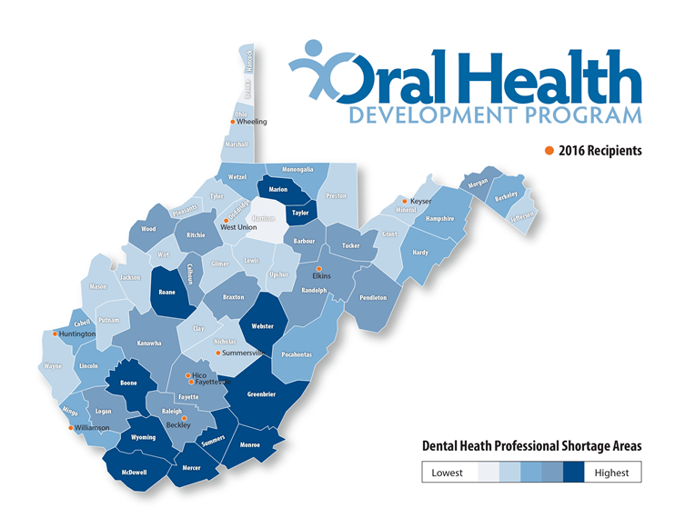
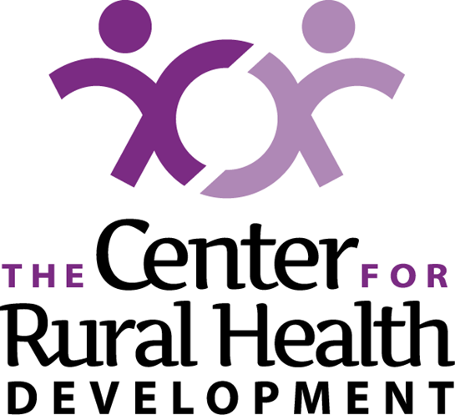
Partnership
The OHP partnered with the Center for Rural Health Development
Low interest loans available

Slide 53
The Supplementary Application Process
The WV State Loan Repayment Program (SLRP)
Key Points:
Available to dentists, primary care physicians, nurse practitioners, nurse midwives, physician assistants
Requires obligated services in the HPSA in WV for a non-profit employer
SLRP will pay for tuition expenses, reasonable training expenses, and living expenses
US citizens who are licensed to practice in WV can apply

Slide 54
State Loan Repayment Program (SLRP)
Criteria:
Must practice full-time general clinical dentistry
Must practice 40 hours per week, 45 weeks per year
Agree not to discriminate against patients on the basis of their ability to pay for their dental services
Complete a minimum 2-year service obligation
Maximum repayment is $40,000.00 over the 2 year obligation
For more information: Brandon.K.Carman@wv.gov

Slide 55
Recruitment and Retention Community Project (RRCP)
Purpose: recruit and retain primary health care providers (general dentists) into underserved communities (DHPSA).
Support can span a maximum of 4 years
Requirements:
Be located in a DHPSA
Provide full continuum of care, 40 hours per week, 45 weeks per year
Have an open policy to provide care regardless of a person’s ability to pay
Be able to provide 50 percent matching dollars from sponsoring community organization
Grant is for $20,000 per year, for a total of $80,000.
For more information: Brandon.K.Carman@wv.gov

Slide 56
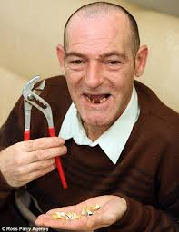
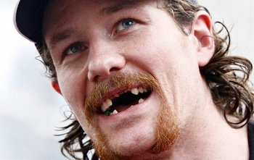
Adults & Seniors

Slide 57
Addressing Lack of Adult Dental Coverage
BCF and BPH Pre-employment (Dental and Vision) Project
This project began in 2000 and provides dental and vision services for adults transitioning from “welfare to work” who are receiving Temporary Assistance for Needy Families (TANF) benefits from the WV DHHR;
Funded by the Bureau for Children and Families through Temporary Assistance for Needy Families (TANF);
Administered by the Bureau for Public Health Oral Health Program;
Lifetime limit for dental services: $3,300/client;
Serves approximately 2,500 people per year.

Slide 58
Addressing Lack of Adult Dental Coverage
BPH Donated Denture Project
State-funded project that provides dentures to residents under age 65 receiving SSI or those over 65 meeting income guidelines (133% of FPL);
Clients must be “denture-ready” – no other services provided;
Client may receive a complete set or partial set of dentures;
Served more than 400 people in both 2014 & 2015.

Slide 59
Oral Health Surveillance & Evaluation

Slide 60
Oral Health Surveillance and Evaluation
What our partners hear …

Slide 61
Oral Health Surveillance and Evaluation
What we want you to know …

Slide 62
Importance of OH Measurement System
Data provides!
Accountability
WV has the ability to establish baselines for objectives and monitor and evaluate progress for current and future goals to improve oral health
Sustainability
WV now has funding from various entities because we have data to show need and evaluate progress

Slide 63
Importance of OH Measurement System
Data drives!
Policy
WV has been able to advance state policy because data informs decisions
Workforce data = Expanded scope of practice for public health hygienists
Workforce data = Higher Education Policy Commission designated loan repayment for dentists (effective 7/2014)
Children’s data = West Virginia Board of Education recommendation for dental examinations for comprehensive approach to student health (WVBE Policy 2423; effective 7/2014)

Slide 64
Current OH Data in WV

Slide 65
State Oral Health Plan 2.0 (2015-2020)
Access to care: Improve access to standardized, comprehensive, continuous oral health services and eliminate disparities for all West Virginians.
Education: Promote educational opportunities and experiences for the public, health professionals, and policy-makers to increase knowledge of oral health and its correlation to overall health.
Prevention: Provide sustainable maintenance of oral wellness through coordinated, integrated and comprehensive services.
Surveillance and Evaluation: Enhance the utilization of the existing statewide surveillance system to measure key indicators of oral health and expand the system to address other data gaps.
Infrastructure and Strategic Partnerships: Solicit, develop, and nurture relationships with other organizations and associations to enhance oral health information and knowledge, as well as to capitalize on unique strengths and resources.

Slide 66
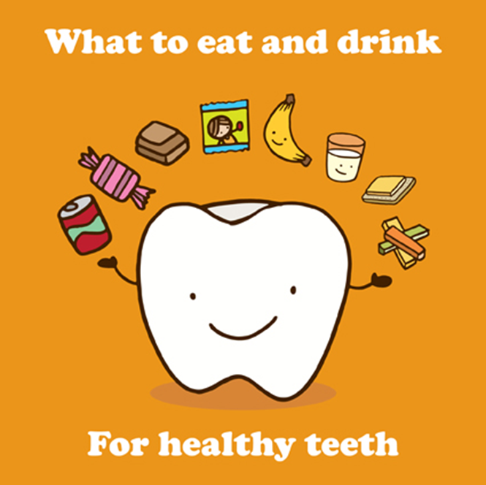
Resources
ReThink Your Drink
www.rethinkyourdrinkwv.org
Children’s Oral Health Resources
http://www.cabellfrn.org/home/dental/
AAP Recommends No Fruit Juice For Children Under 1 Year
https://www.aap.org/en-us/about-the-aap/aap-press-room/pages/american-academy-of-pediatrics-recommends-no-fruit-juice-for-children-under-1-year.aspx

Slide 68
Thank you!
For more information, contact:
Dr. Jason Roush, State Dental Director
Jason.M.Roush@wv.gov
www.dhhr.wv.gov/oralhealth

