Slide 1
Neonatal Abstinence Syndrome
M. Cody Smith, MD
Neonatology
WVU Medicine Children’s

Slide 2
Objectives
Review common terms and definitions and statistics related to neonatal abstinence syndrome
Review the available assessment tools for withdrawal
Understand appropriate non-pharmacologic therapies
Review the pharmacologic agents routinely used for withdrawal
Discuss the nutritional implications of neonatal abstinence syndrome
Discuss neurodevelopment concerns and follow-up

Slide 3
Definitions
Addiction
A primary, chronic, neurobiological disease with genetic, psychosocial, and environmental factors that influence its development and manifestation
Physical dependence
A state of adaptation that is manifested by a drug class-specific withdrawal syndrome
Neonatal abstinence syndrome
A form of physical dependence resulting from in utero exposure to opioids, anxiolytics, antidepressants, antipsychotics, and other substances
NOWS: Neonatal Opioid Withdrawal Syndrome

Slide 4
Neonatal Abstinence Syndrome (NAS)
Clinical diagnosis
Results from abrupt discontinuation of chronic fetal exposure to substance used by the mother during pregnancy
Between 2009 and 2011, the diagnosis of NAS has increased from 1.2 to 3.4 per 1000 live births
Substances involved include:
Morphine, heroin, methadone, buprenorphine, prescription opioids, antidepressants, anxiolytics, nicotine, and other substances

Slide 5
How much has the incidence of neonatal abstinence syndrome (NAS) increased in the last decade ?
100%
200%
300%
400%
National inpatient data shows NAS admissions have increased from 1.2 to 5.8 per 1000 hospital births from 2000-2012; an increase of 480%.
Adapted from Patrick SW, Davis MM, Lehmann CU, Cooper WO. Increasing Incidence and Geographic Distribution of Neonatal Abstinence Syndrome: United States 2009-2012. In Press.

Slide 6
How much money did the United States spend on infants with NAS in 2012
< $ 500 Million b. $ 750 Million c. $ 1 Billion d. > $ 1.25 Billion

Slide 7
State Medicaid Programs Paying the Majority of the Cost
Cost is 15 to 16 times higher than healthy infants
Cost is rising –Mean hospital charges for discharges with NAS increased from $39,400 in 2000 to $53,400 in 2009
Patrick, S., Schumacher, R., Benneyworth, B., Krans, E., Mcallister, J., & Davis, M. (2013). Neonatal Abstinence Syndrome and Associated Health Care Expenditures. Obstetric Anesthesia Digest, 33(2), 86.
Roussos-Ross, K., Reisfield, G., Elliot, I., Dalton, S., & Gold, M. (2015). Opioid Use in Pregnant Women and the Increase in Neonatal Abstinence Syndrome. Journal of Addiction Medicine, 9(3), 222-225.

Slide 8
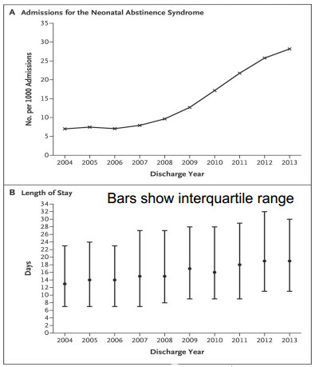
Pediatrix Clinical Data Warehouse
Large, multicenter, deidentified data set
Includes ~ 20% of infants admitted to US NICUs
Queries: NAS, Drug
Withdrawal or Drug
Withdrawal Syndrome
2004-2013
Among 674,845 infants admitted to 299 NICUs, 10,327 with NAS (1.5%)
Notes:
The rate of NICU admissions for the neonatal abstinence syndrome increased from 7 cases per 1000 admissions to 27 cases per 1000 admissions
The total percentage of NICU days nationwide that were attributed to the neonatal abstinence syndrome increased from 0.6% to 4.0%

Slide 9
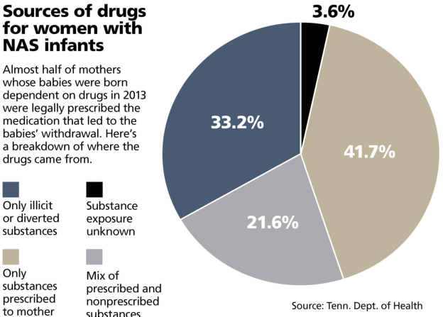
The Tennessean: “Born Hurting”, by Tony Gonzalez & Shelley DuBois

Slide 10
Prescription Narcotics
Commonly Prescribed:
Indications:
Oxycodone (OxyContin)
Oxycodone + Acetaminophen (Percocet)
Hydrocodone + Acetaminophen (Vicodin)
Fentanyl (patch)
Tramadol (Ultram)
Methadone
Buprenorphine (Subutex)
Post-procedural/surgical pain
Chronic pain
Sleep disorders
Drug replacement therapy
Opioid addiction
Opioid dependence

Slide 11
Heroin
Heroin use more than doubled among young adults ages 18–25 in the past decade.
More than 9 in 10 people who used heroin also used at least one other drug.
45% of people who used heroin were also addicted to prescription opioid painkillers.
Today’s Heroin Epidemic. (2015). Retrieved January 11, 2016, from http://www.cdc.gov/vitalsigns/heroin/

Slide 14
NAS in West Virginia

Slide 15
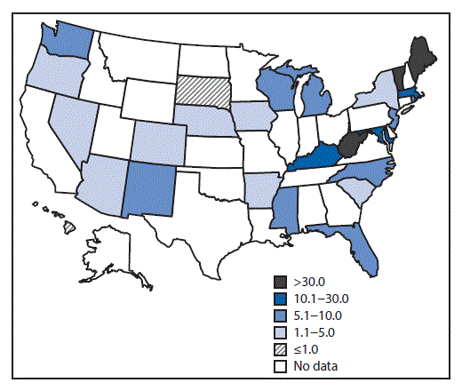
NAS and West Virginia
CDC data from 2012-2013

Slide 16
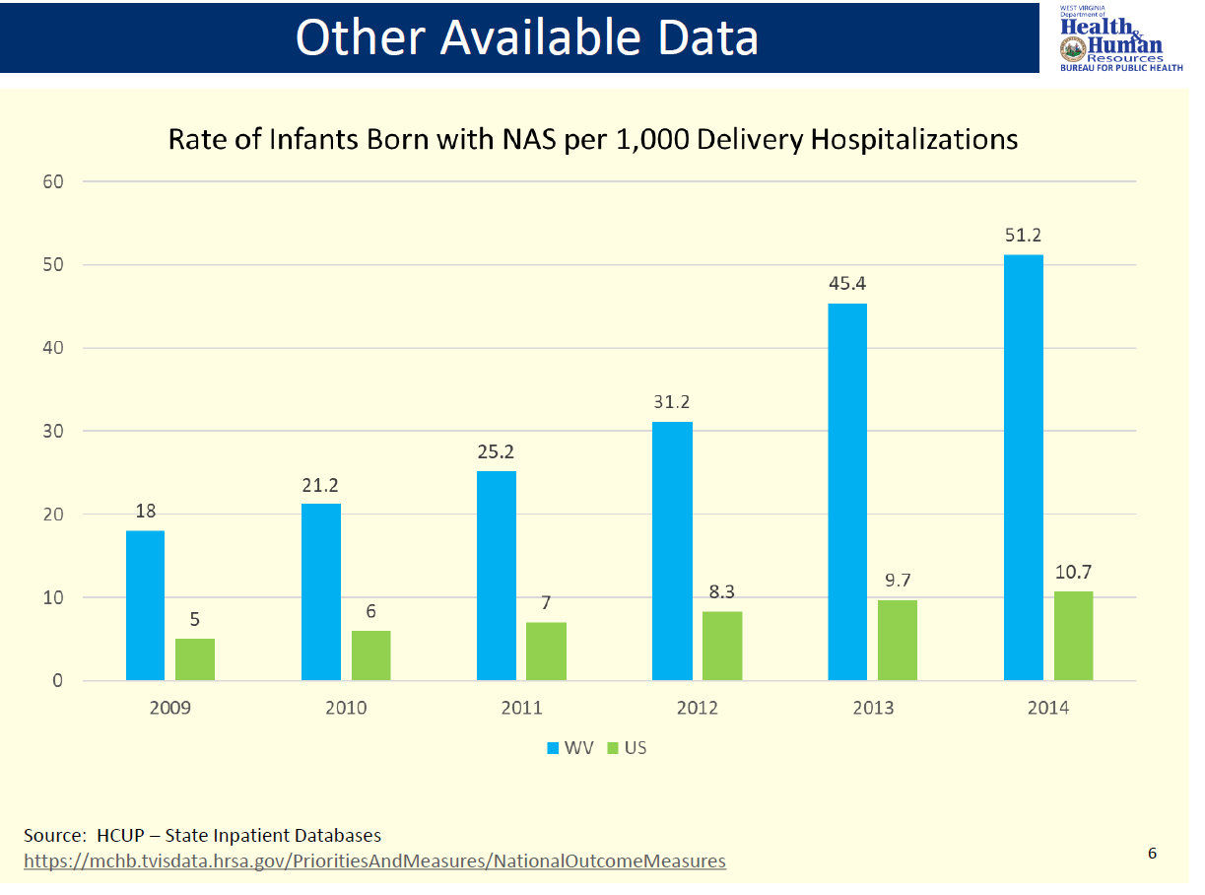

Slide 18
Screening
How do we identify patients at risk?

Slide 19
Neonatal Screening
Urine toxicological screen
Screens for “recent” exposure
Can be a difficult collection
Meconium screening
Screens for exposure over months
Can have delayed collection
Cord tissue screen
Screens for exposure over months
Readily available for all infants

Slide 20
Screening at WVU Medicine
Universal urine toxicology screening for mother’s at time of admission to labor and delivery
Universal umbilical cord toxicology screening for all infants born at Children’s
Universal meconium toxicology screening for all infants transferred to Children’s

Slide 21
Scoring
How do we monitor the severity of withdrawal?

Slide 22
NAS Scoring Scales
Finnegan Neonatal Abstinence Scoring Tool
31 items
Modified Finnegan Scoring System
21 of the original items
Reorganized into 3 categories
Lipsitz Neonatal Drug- Withdrawal Scoring System
11 items
Neonatal Withdrawal Inventory
Neonatal Narcotic Withdrawal Index
Notes:
Original Finnegan and Lipsitz tools were published in 1975.
The modified finnegan in 1986

Slide 23
Modified Finnegan Scoring System
Hudak M L et al. Pediatrics 2012;129:e540-e560

Slide 24
Challenges for Consistency in Scoring
Even though consistent training of staff to utilize assessment tools can increase interrater reliability, scoring with caregivers still remains subjective (Wiles, Ward, & Akinbi, 2014).

Slide 25
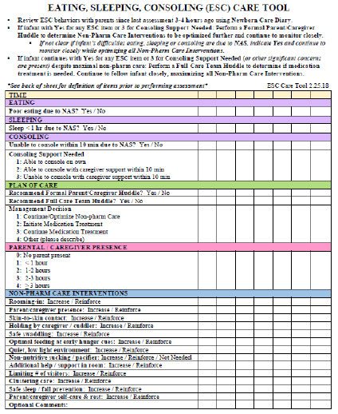
The “Eat, Sleep, Console” (ESC) Assessment Tool and Training Materials are copyrighted by Boston Medical Center Corporation, Dr. Matthew Grossman, Mary Hitchcock Memorial Hospital, Dartmouth-Hitchcock Clinic (2017).

Slide 26
Signs and Symptoms
Neurologic Signs
Tremors; Jitteriness
Seizures
Irritability; Sleeplessness
High-pitched cry
Hypertonia; exaggerated Moro
Yawning; sneezing
Respiratory pauses/desaturations
Autonomic Instability
Sweating
Temperature Instability
Fever
Mottling
Nasal Stuffiness
Tachypnea
GI dysfunction
Poor feeding
Uncoordinated/constant sucking
“Reflux”/Vomiting
Diarrhea (leads to diaper rash; pain)
Dehydration
Poor weight gain

Slide 27
Treatment
No established optimal treatment
2005 Cochrane reviews suggest lack of high-quality evidence for any specific treatment

Slide 28
Treatment
Enable infant to feed and gain weight
Frequently need increased caloric density of formula due to high metabolic rate
Prevent seizures and other morbidities
Reduce unnecessary hospitalization
Improve/monitor family interaction/care
Reduce infant mortality; improve outcomes
**Limit additional opioid exposure**

Slide 29
AAP Guidelines NAS (Hudak Pediatr 129:e540, 2012)
Initiate non-pharmacologic measures first
The optimal threshold ‘score’ for initiating pharmacologic therapy is unknown
Breast-feeding should be encouraged if no illicit drug use
Oral morphine, methadone—best evidence (but limited); clonidine—emerging evidence
Observe exposed infants for 4-7 days
Treatment of drug withdrawal may not alter long-term outcome

Slide 30
Non-Pharmacologic Care
Should always be implemented first, and continued as an adjunct to drug treatment
Decreased environmental stimulation
Room in, if feasible
Tight swaddling; Kangaroo care
Rocking/swinging
Non-nutritive/nutritive sucking—Breast is best!
Demand and/or frequent, small feedings
Butt care – prophylactic to prevent breakdown

Slide 31
Pharmacologic Treatment
“Withdrawal from opioids…may be life-threatening, but ultimately drug withdrawal is a self-limited process”
“Unnecessary pharmacologic treatment will prolong drug exposure and the duration of hospitalization”
“The only clearly defined benefit of pharmacologic treatment is the short-term amelioration of clinical signs”
Prompt escalation of treatment to control clinical signs
2012 AAP Statement on Neonatal Drug Withdrawal

Slide 32
6 Basic Principles of Caring for an Infant with Neonatal Abstinence Syndrome Swaddling Positioning Motion Handling Oral Stimulation Environment & Stimulation
Non-Pharmacological Management

Slide 33
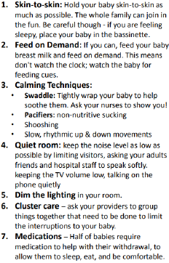
Care-Giver Quick Tips

Slide 34
Swaddling
Substance exposed infants can struggle to do multiple physiologic tasks simultaneously (for example: control their bodies, breathe and suck at the same time.)
If infants are focused on controlling the discomfort in their bodies, they cannot focus on feeding or sleeping.
We cannot eat, sleep or breathe for the infants but we can help control the their bodies for them.
We do that by swaddling or wrapping them snugly to control their movements and provide comfort.

Slide 35
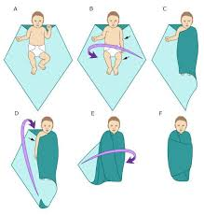
Swaddling

Slide 36
Positioning
The C-Position
Holding or laying a baby in a “C-position” increases the infant’s sense of control and ability to relax.
Hold the baby firmly and curl the head and legs into a “C”. In doing so, the baby’s chin is resting near his chest with the arms midline; his back is slightly rounded with legs bent in an upright position.
If he is allowed to stiffen he back, arms or legs, he is increasing his body tone and burning precious calories that he needs to grow. It is also possible that by holding him close to your body, it is too stimulating for him.
When laying infant down, use the c-position and contain them on the bed this way until they are calm and fall back asleep.

Slide 37
Positioning
Side/stomach position
Place the infant on their left side to assist
in digestion or on their stomach to provide reassuring support.
The side/stomach position needs to be monitored at all times. Infant must return to BACK to SLEEP once if parents/caregiver are not actively watching infant.
Notes:
Preach Back to Sleep! Infant should be monitored at all times while side lying or prone. If parent has to walk away form infant or not watching infant for any reason, infant should be moved to their backs.

Slide 38
Motion
Swaying
A slow, rhythmic swaying following a line from head to toe with the baby swaddled and held firmly in the C-position is calming.
Keeping your movements slow and rhythmic will help to relax and settle the infant.
Vertical Rock
A head- to-toe movement is soothing to the baby’s neurological system, as is keeping the baby away from your body.
When you are holding a baby who is frantic and very hard to calm, you can maintain a C-position hold directly in front of you, with the infant two inches away from your body and facing away. Then slowly and rhythmically move the baby up and down.

Slide 39
“The Hold”
Notes:
Start at about 1:10

Slide 40
Handling
Clapping
Another technique that can help the baby relax is to clap his diapered and blanketed bottom. By cupping your hand and clapping or patting slowly and rhythmically, you will be able to feel the baby’s muscles relax.
This principle can be very soothing for some but can have the opposite effect and cause over-stimulation for hypersensitive infants.
Closeness
Hold close to body.
May not be calming to some.
Containment
Use swaddling, or use your hands once the baby is laid in bed for containment. Wrap a blanket into a roll and ring it around his body to ensure he remains contained.
Notes:
Remove: Wrap a blanket into a roll and ring it around his body to ensure he remains contained.

Slide 41
Oral Stimulation
Sucking naturally produces soothing endorphins.
Offer pacifier to calm baby- also decreases SIDS risk!
Feeding:
The key to feeding is to get your baby into a therapeutic hold and relaxed enough to suck. Always feed in a low-stimulus environment--no bright lights, music, noise or other distractions. Make sure the baby is swaddled and held in a C-position.
Too much feeding can cause an upset stomach- please feed as instructed and do not feed just because the baby is crying and apply other techniques to calm baby.

Slide 42
Oral Stimulation
Babies withdrawing from opiates often suck frantically making it difficult for them to take in enough breast milk or formula because their suck may be also disorganized.
There stress levels may be so high that they simply cannot organize an effective suck without help.

Slide 43
Environment & Stimulation
Controlling the Environment:
To maximize other basic principles, limit the number of caregivers and offer a calm surrounding.
Loud noises increase their distress. It is best to turn down TVs and music and to limit loud voices surrounding the baby.
Also, during the first weeks of withdrawal, overhead lights may be over stimulating.
Routine is very important.
The baby will respond more positively when caregivers use soft voices and speak and move slowly.

Slide 44
Environment & Stimulation
A substance exposed infant needs to have stimulation introduced in small doses and on a schedule dictated by his individual ability to adjust.
It is best to go slowly and introduce stimuli one at a time. (This can include light, sound, touch, voice, etc.).
Example: First, see how he responds to having his swaddling loosened. Then, try gentle rocking or talking. If he shows signs of stress return to the therapeutic handling techniques for a while longer. This introducing of stimuli can take time and patience on the caregiver’s part. Watch for clues from the baby. Interact with the baby when she is ready and in an active/alert state.
Notes:
Gradual stimulation

Slide 45
The 5 S’s of Soothing
How to Rapidly Calm a Frantic Baby:
Swaddling
Side positioning
Shushing Sounds
Swinging
Sucking
Notes:
Shushing imitates the whooshing sounds in the womb. Put lips near infant’s ear, Shush as loud as infant is crying, as baby calms lower shushing volume to match infant.

Slide 46
Other Interventions for NAS Infants
Infants do better with consistent care.
Do not overdress infant.
Protect from scratching/rubbing- use mittens or socks.
Always practice safe sleep for infants
Notes:
Remind parents that they are the best caregivers. Parents should practice Skin to Skin care: aids in brain development, stabilizing vital signs and mood, helps with weight gain. Remind parents that if an infant isn’t going to be held and interacted with for a measurable amount of time (45 minutes) or until next feeding time, infant should be allowed to rest until next feed. Don’t wake and run.

Slide 47
Breast Feeding
Benefits:
Maternal-infant bonding
Readily available/cheap food source
Immune factors/Gut protection
Particularly important in preterm infants
May ease drug withdrawal symptoms
Concerns
Drug toxicity (all cross into breast milk)
Maternal inattention, sleepiness
Risk for infection (specifically, HIV)
Hep C with cracked/bleeding nipples
Secondary smoke—increased risk for SIDS
Notes:
Hep C

Slide 48
Breast Feeding
Growing body of literature supports breastfeeding on methadone maintenance
Jansson LM et.al. Pediatr 121: 106, 2008
Less need for drug treatment of NAS
Despite low and unpredictable levels of methadone in breast milk and infant serum
And no evidence of significant methadone transfer to infants in breast milk

Slide 49
Breast Feeding
Recommended for mothers receiving medication assisted treatment (methadone/buprenorphine)
Similar benefits to women without SUD
Additional benefit of reduced severity of NAS for infants
Should be avoided for women with active substance use
Women using marijuana should be educated about eliminating use while breast feeding

Slide 50
Pharmacologic treatment

Slide 51
Morphine
Drug class: opioid
Use: primary treatment for NAS
Half-life:
Infants < 6 months: ~ 6-7 hours
Infants > 6 months: ~ 3 hours

Slide 52
Methadone
Drug class: Opioid
Use: Primary treatment for NAS
Can be used for NOWS or NAS
Half-life: Children: 4-62 hours

Slide 53
Clonidine
Drug class: Alpha-adrenergic agonist
Use: mostly used as adjunct treatment of NAS
Half-life:
Neonates: 44- 72 hours
Children: 8-12 hours

Slide 54
Phenobarbital
Drug class: Barbiturate
Use: Adjunct treatment for NAS
Half-life:
Neonates: 45- 500 hours
Infants: 20- 133 hours

Slide 55
Pharmacologic Therapy
Current recommendations are to standardize therapy
Morphine or methadone have been the mainstays of treatment
New data emerging on using buprenorphine
Adjunct treatment uses phenobarbital or clonidine

Slide 56
Nutrition Implications

Slide 57
In Utero Opioid Exposure
Lower birth weight
Increased preterm birth rate
Reduced fetal growth parameters
Associated neonatal problems
Hypoglycemia
Anemia
Respiratory distress
Delayed transition

Slide 58
Oral Feeding
Early: uncoordinated suck/swallow, gulping of formula, or poor intake during feeding leads to excessive weight loss or inadequate weight gain.
Late: Hyperphagia (High volumes) but may still have inadequate weight gain

Slide 59
Increased metabolic demand=need for more Calories
Tremors; Jitteriness
Seizures
Irritability; Sleeplessness
High-pitched cry
Hypertonia; exaggerated Moro
Sweating
Temperature Instability
Fever
Tachypnea

Slide 60
Energy Requirements
Adequate intake to achieve growth.
Some infants may require up to 200 kcal/kg/day
Healthy Term Infants generally growth with ~100 kcal/kg/day
Many NAS infants will require formula mixed at a higher caloric density to achieve adequate growth
Increased caloric demand may be related to in utero exposure (which agent)

Slide 61
High Calorie Formula
Early initiation of high-calorie formula for infants with prenatal methadone exposure may be beneficial for weight gain
Hospital Pediatrics 2018;8;7 Methadone-Exposed Infants: A Feasibility Study Randomized Clinical Trial of Standard- Versus High-Calorie Formula for

Slide 62
GI Symptoms
“Reflux”/Vomiting
Diarrhea (leads to diaper rash; pain)
Dehydration
Poor weight gain
Skin breakdown=increased needs
Malabsorption questions with diarrhea

Slide 63
GI Symptoms
Gas Pain
Minimize frantic hunger
Appropriate bottles
Frequent burping
Minimize crying
Infant Massage
Vomiting/Loose Stools
Low osmolality formula
Low/no lactose formula

Slide 64
Breastfeeding
Breast is still best.
Use of breast milk will vary based on policies of each facility
Do not discourage mothers from breastfeeding if they are in treatment programs.
Mothers and Babies are often separated. Please support efforts to pump to provide breast milk.
Please do not discourage pacifier use in this population.

Slide 65
NeuroDevelopment concerns & Follow-up

Slide 66
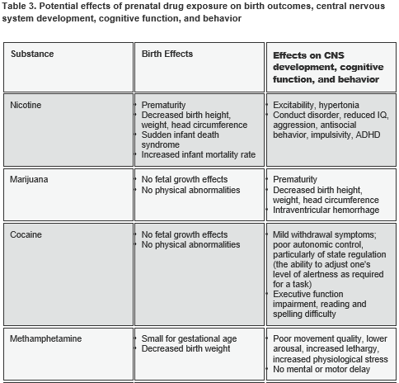
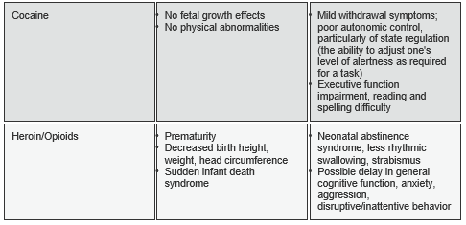
ND Concerns & F/U
Wendell AD. Overview and epidemiology of substance abuse in pregnancy. Clin Obstet Gynecol . 2013;56:91-96.
Behnke M, Smith VC, Committee on Substance Abuse, Committee on Fetus and Newborn. Prenatal substance abuse: short- and long-term effects on the exposed fetus. Pediatrics . 2013;131:e1009-e1024. Available at pediatrics.aappublications.org/content/131/3/e1009.full.pdf+html.
Queensland Maternity and Neonatal Clinical Guidelines Program. Neonatal abstinence syndrome. 2010; Queensland, Australia. Available at www.health.qld.gov.au/qcg/documents/g_nas5-0.pdf.

Slide 67
ND Concerns & F/U
Chronic opiate use in pregnancy appears to increase the risk for a HC ≤ 10th percentile and ≤ 3rd percentile when compared with controls. From ultrasound findings, femur and humerus lengths also appear to be shortened suggesting a possible effect on bone growth.
Chronic Opiate Use in Pregnancy and Newborn Head CircumferenceAmerican Journal of Perinatology 2015; 01: 027-032 DOI: 10.1055/s-0034-1374817

Slide 68
ND Concerns & F/U
Children treated for NAS scored significantly lower than the norm on all 3 subscales (cognitive, language, motor).
Children who lived with foster/adoptive families at follow up had higher cognitive scores than those who lived with biological relatives, especially motor scores.
8% of children required treatment for strabismus.
Merhar, S. L., McAllister, J. M., Wedig-Stevie, K. E., Klein, A. C., Meinzen-Derr, J., & Poindexter, B. B. (2018). Retrospective review of neurodevelopmental outcomes in infants treated for neonatal abstinence syndrome. Journal of Perinatology, 38(5), 587–592. https://doi.org/10.1038/s41372-018-0088-9

Slide 69
ND Concerns & F/U
Initial hospital discharge f/u- 2-3 days
May need more frequent visits to monitor symptoms (can last weeks) and growth closely
Early intervention services recommended
May need close monitoring of vision (strabismus)
May need higher calorie or special formulas (WIC)

Slide 70
Thank You!

