Slide 1

A Standardized Approach for Treating Infants at Risk for Neonatal Abstinence Syndrome
M. Cody Smith, MD and Casey McCord RN, BSN
WVU Medicine Children’s Hospital
Department of Pediatrics

Slide 2
Wvu medicine Children’s quality Improvement committee for nas
Our Story to Standardization and Improved Care

Slide 3
Baseline Data
Timeframe: January 2009- December 2011
All infants admitted to WVU Children’s with:
  ICD-9 760.7x (Noxious influences affecting fetus or newborn via placenta or breast milk) or
  779.5 (Drug withdrawal syndrome in newborns)
358 total infants
  129 born < 37 wga
  155 born ≥ 37 wga tx non-pharmacologically
  61 born ≥ 37 wga tx pharmacologically
  13 term infants excluded due to congenital heart of GI anomaly

Slide 4
Baseline Data- Treated
39% (61/ 216) of term infants received pharmacotherapy
  60 infants received morphine (98%)
  2 infants received methadone (3.3%)
Mean LOS = 22 days (SD 10.7)
Median LOS = 20 days (Range 5-61 days)
46% of treated infants with LOS > 21 days
5% of treated infants received any breast milk 24 hours prior to discharge

Slide 5
Timeline
July 2012: Established multidisciplinary committee
Nov & Dec 2012: NICU nursing education for scoring
January 2013: NAS Treatment algorithm Go-Live
February 2013: MICC nursing education for scoring
April 2013: Universal umbilical cord screening
March –Dec 2013: Regular reporting of guideline compliance
June 2014: Parent education pamphlet developed
July 2014: Breastfeeding guideline implemented
September 2014: Non-pharmacologic education
Jan 2016: Re-boot of active committee participation
Aug 2017: Changed from Phenobarbital to Clonidine as 2nd line adjunct treatment agent of choice
Dec 2017: Improved Rooming in
Notes:
Also took place in OVN NAS iNIQU

Slide 6
Areas of Emphasis
Screening
Maternal drug history
Monitoring (Scoring)
Modified Finnegan’s tool
Non-pharmacologic
Physical
Pharmacologic
Maternal toxicological testing
Neonatal toxicological testing
Emotional
Social
Environ-mental
Morphine
Phenobarbital
Clonidine
Education and Validation

Slide 7
Screening

Slide 8
AAP Recommendation
    Screening for NAS should begin with a careful maternal history and physical examination
    Toxicological testing, as needed
    Multiple risk factors include maternal report or documentation of substance use, late entry into care or no prenatal care, previous unexplained late fetal demise, precipitous labor, and placental abruption
    Infants at risk for intrauterine exposure and neonatal withdrawal should be observed for 4-7 days after birth
Source: Mark L. Hudak, MD, Rosemarie C. Tan, MD,, PhD, THE COMMITTEE ON DRUGS, and THE COMMITTEE ON FETUS AND NEWBORN, American Academy of Pediatrics, doi:10.1542/peds.2011-3212.

Slide 9
Screening
Universal maternal urine toxicology screening at admission to labor and delivery
Universal umbilical cord toxicology screening for all inborn infants
Universal meconium toxicology screening for all outborn infants

Slide 10
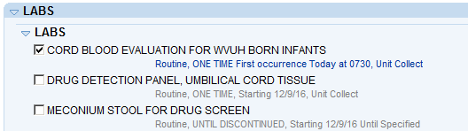
Drug Screening
Collect: at least 6 inches of umbilical cord.
Specimen Preparation:
  Drain and discard any blood.
  Rinse the exterior of the cord segment with normal saline or an equivalent.
  Pat the specimen dry and place in container for transport.
Meconium specimen needs to be a minimum of 1 gram, but 5 grams is preferable
Notes:
6 inches is approximately the length of an adult hand

Slide 11
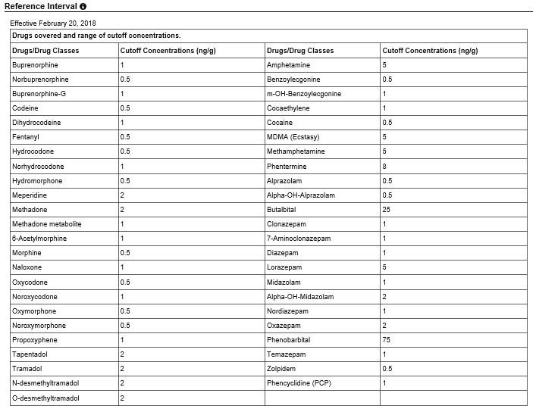
Umbilical Cord Sampling
ARUP Lab
Ambient: 1 week
Refrigerated: 3 weeks
Frozen: 1 year
“Drug Detection Panel, Umbilical Cord, Qual”: This test has a charge of :$224. There are 24 drugs that are tested, but there is NO quantitative additional testing performed ( no “reflex” testing)
Notes:
Reported in 1-3
Methodology: Qualitative Liquid Chromatography/Tandem Mass Spectrometry
Detection of drugs in umbilical cord tissue is intended to reflect maternal drug use during pregnancy. The pattern and frequency of drug(s) used by the mother cannot be determined by this test. A negative result does not exclude the possibility that a mother used drugs during pregnancy. Detection of drugs in umbilical cord tissue depends on extent of maternal drug use, as well as drug stability, unique characteristics of drug deposition in umbilical cord tissue, and the performance of the analytical method. Drugs administered during labor and delivery may be detected. Detection of drugs in umbilical cord tissue does not insinuate impairment and may not affect outcomes for the infant. Interpretive questions should be directed to the laboratory. Glucuronide metabolites are indicated as -G.

Slide 12
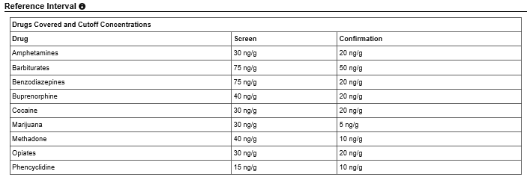
Meconium Sampling
ARUP Lab
Ambient: 1 week
Refrigerated: 3 months
Frozen: 1 year
“Meconium Drugs of Abuse Panel, with Reflex”: This test has a charge of : $108. If there are any drugs that are “Positive” then this test will perform the “Quantitative” test on up to 9 drugs, for an additional charge for each one. (SO, the $108 is the base, but the price could vary depending on the additional testing performed).
Notes:
Report in 1-4 days
If the specimen screens positive, then Confirmation/Quantitation by LC-MS/MS will be added. Additional charges apply.
Unless ARUP is otherwise notified, reflex confirmation testing will be performed in the following order of priority:
Amphetamines (0.125 g sample required)
Cocaine (0.25 g sample required)
Opiates (0.125 g required)
Buprenorphine (0.125 g required)
Marijuana (0.125 g required)
Benzodiazepines (0.125 g sample required)
Methadone (0.125 g sample required)
Phencyclidine - PCP (0.25 g sample required)
Barbiturates (0.25 g sample required)

Slide 13
Scoring

Slide 14
Scoring
Conducted in person education for all nurses caring for infants at risk of NAS
  ~ 45 minutes- 1 hour per class
  Required attendance through multiple sessions
“Inter-Observer Reliability Program”
  NeoAdvances- Karen D. A’Polito

Slide 15
Scoring
Infants > 35 weeks gestation
  MICC- Scoring should begin within 2 hours of birth
  NICU- Scoring should begin within 6 hours of birth
  Continued for 5 days minimum
Infants < 35 weeks gestation
  Scoring initiated only if signs of withdrawal
  Follow standard guideline

Slide 16
Scoring
There are several standardized scoring systems available that can assist caregivers with both identification and quantification severity of NAS infants (Wiles, Ward, & Akinbi, 2014)
Neonatal Abstinence Scoring Tools:
  Lipsitz Tool
  Neonatal Narcotic Withdrawal Index
  Neonatal Withdrawal Interventions
  Finnegan Neonatal Abstinence Score
Finnegan Neonatal Abstinence Scoring Tool (FNAST) is a clinical tool developed by Dr. Loretta Finnegan. that contains 21 signs/symptoms to be assessed (D'Apolito, 2010).
The most comprehensive tool currently used is the modified Finnegan

Slide 17
Challenges for Consistency in Scoring
Even though consistent training of staff to utilize assessment tools can increase interrater reliability, scoring with caregivers still remains subjective (Wiles, Ward, & Akinbi, 2014)

Slide 18
Scoring Definitions
Crying:
Healthy, normal infant is usually able to console themselves within 15 seconds by sucking on hands or fingers. If they continue to cry a caregiver can usually quiet them by holding or rocking unless they are very hungry or in pain.
Excessive High-pitched
Score 2 & 3
When infant can’t stop crying within the 15 second window or continues to cry intermittently/continuously for up to 5 minutes. Greater than 5 minutes, score a 3.
Pitch can vary with infants, so if cry is high-pitched, but doesn’t have other symptoms, it should not be scored as a 2 or a 3 (Finnegan, 1991).

Slide 19
Scoring Definitions
Sleep:
Defined as the longest period of time in a 3 hour period.
Example:
Infant sleeps from 1200-1230, goes back to sleep from 1230-1430 and remains awake until 1500.
1200-1230= 30 minutes
1230-1400= 90 minutes
Infant would receive a score of 2 ( baby sleeps < 2hours), since longest period of time sleeping was 90 minutes.

Slide 20

Scoring Definitions
Moro reflex:
Moro is a normal newborn reflex that evaluates infant’s CNS
Hyperactive Moro
Score 2
Infant with pronounced jitteriness of hands during or at end of Moro reflex. Jitteriness is defined as rhythmic tremors that are symmetrical & involuntary (Finnegan, 1991).
** prior to eliciting a Moro reflex, infant should be quiet so jitteriness that may be present is related to withdrawal not agitation (Finnegan, 1991).
Score 3 for infants with both jitteriness & clonus
Clonus is defined as repetitive, rhythmic jerks.

Slide 21
Scoring Definitions
Excoriation: Defined as rub marks on the skin ( chin, knees, elbows, toes or nose)
A reddened diaper area does NOT count as excoriation, but as a result of loose or watery stools which is scored separately
Excoriation should continue to be scored until the rub marks on skin are no longer present

Slide 22
Scoring Definitions
Frequent yawning: more than 3 times in a testing period
Mottling: Marbled or lacey appearance on the skin
Nasal stuffiness: Noisy respirations related to nasal secretions
Sneezing: more than 3 times within the scoring interval
Nasal flaring: outward spreading of nostril
Respiratory rate: > 60 score 1, > 60 with retractions score 2
Excessive sucking: frantic rooting
Poor feeding: uncoordinated suck/swallow, gulping of formula, or poor intake during feeding

Slide 23
Scoring Definitions
Regurgitation & vomiting: score 2 for regurgitation not associated with burping
Stools: score 2 for loose stools and 3 for any type of stool accompanied by a water ring
Sweating: do not score for sweating if due to overheating (too many blankets or overdressing)
Fever: score a 1 for axillary 37.2-38.3 & score a 2 > 38.4

Slide 24
Scoring Definitions
Myoclonic Jerks: involuntary spasms or twitching of a muscle. Rarely seen in infants, but would be seen as quick movements of short duration.
Convulsions: seizure activity may be present with CNS irritability in 2 % to 11% of opioid exposed infants (Finnegan, 1991).
Seizures typically occur late, when infants were around 10 days old.

Slide 25
Non-Pharmacologic Treatment

Slide 26
Non-Pharmacological
Management
Non-pharmacologic treatment should begin at first signs of NAS
  Swaddling
  Positioning
  Motion
  Handling
  Oral Stimulation
  Environment & Stimulation

Slide 27
Swaddling
  Drug exposed infants can struggle to do multiple physiologic tasks simultaneously (for example: control their bodies, breathe and suck at the same time.)
  If infants are focused on controlling the discomfort in their bodies, they cannot focus on feeding or sleeping.
  We cannot eat, sleep or breathe for the infants but we can help control the their bodies for them.
  We do that by swaddling or wrapping them snugly to control their movements and provide comfort.

Slide 28
Swaddling
If using a square cloth, fold back one corner creating a straight edge.
2. Place the baby on the cloth so that the top of the fabric is at shoulder level. If using a rectangular cloth, the baby’s shoulders will be placed at the top of the long side.
3. Bring the left arm down. Wrap the cloth over the arm and chest. Tuck under the right side of the baby.
4. Bring the right arm down and wrap the cloth over the baby’s arm and chest.
5. Tuck the cloth under the left side of the baby. The weight of the baby will hold the cloth firmly in place.
6. Twist or fold the bottom end of the cloth and tuck behind the baby, ensuring that both legs are bent up and out.
Notes:
It is important to take care to protect infant’s hips. To decrease risk of hip dysplasia, swaddle infants so they have ample room to move legs and feet.

Slide 29

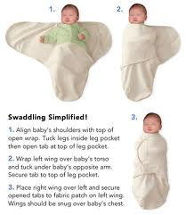
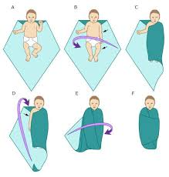
Swaddling

Slide 30

Positioning
  The C-Position
    Holding or laying a baby in a “C-position” increases the infant’s sense of control and ability to relax.
    Hold the baby firmly and curl the head and legs into a “C”. In doing so, the baby’s chin is resting near his chest with the arms midline; his back is slightly rounded with legs bent in an upright position.
    If he is allowed to stiffen his back, arms or legs, he is increasing his body tone and burning precious calories that he needs to grow. It is also possible that by holding him close to your body, it is too stimulating for him.
    When laying infant down, use the c-position and contain them on the bed this way until they are calm and fall back asleep.

Slide 31
Positioning
  Side/stomach position-
    Place the infant on their left side to assist
    in digestion or on their stomach to provide reassuring support.
The side/stomach position needs to be monitored at all times. Infant must return to BACK to SLEEP once if parents/caregiver are not actively watching infant.
Notes:
Preach Back to Sleep! Infant should be monitored at all times while side lying or prone. If parent has to walk away form infant or not watching infant for any reason, infant should be moved to their backs.

Slide 32
Motion
  Swaying
    A slow, rhythmic swaying following a line from head to toe with the baby swaddled and held firmly in the C-position is calming.
    Keeping your movements slow and rhythmic will help to relax and settle the infant.
  Vertical Rock
    A head- to-toe movement is soothing to the baby’s neurological system, as is keeping the baby away from your body.
    When you are holding a baby who is frantic and very hard to calm, you can maintain a C-position hold directly in front of you, with the infant two inches away from your body and facing away. Then slowly and rhythmically move the baby up and down.

Slide 33
Handling
  Clapping
    Another technique that can help the baby relax is to clap his diapered and blanketed bottom. By cupping your hand and clapping or patting slowly and rhythmically, you will be able to feel the baby’s muscles relax.
    This principle can be very soothing for some but can have the opposite effect and cause over-stimulation for hypersensitive infants.
  Closeness
    Hold Close to body
    May not be calming to others
  Containment
    Use swaddling, or use your hands once the baby is laid in bed for containment.

Slide 34
Oral Stimulation
    Sucking naturally produces soothing endorphins.
    Offer pacifier to calm baby.
  Feeding:
    The key to feeding is to get your baby into a therapeutic hold and relaxed enough to suck. Always feed in a low-stimulus environment--no bright lights, music, noise or other distractions. Make sure the baby is swaddled and held in a C-position.
    Too much feeding can cause an upset stomach- please feed as instructed and do not feed just because the baby is crying and apply other techniques to calm baby.

Slide 35

Oral Stimulation
  Babies withdrawing from opiates often suck frantically making it difficult for them to take in enough formula because their suck may be also disorganized.
  There stress levels may be so high that they simply cannot organize an effective suck without help.

Slide 36
Environment & Stimulation
  Controlling the Environment:
    To maximize other basic principles, limit the number of caregivers and offer a calm surrounding.
    Loud noises increase their distress. It is best to turn down TVs and music and to limit loud voices surrounding the baby.
    Also, during the first weeks of withdrawal, overhead lights may be over stimulating.
    Routine is very important.
    The baby will respond more positively when caregivers use soft voices and speak and move slowly.

Slide 37
Environment & Stimulation
    A drug exposed infant needs to have stimulation introduced in small doses and on a schedule dictated by his individual ability to adjust.
    It is best to go slowly and introduce stimuli one at a time. (This can include light, sound, touch, voice, etc.).
    Example: First, see how he responds to having his swaddling loosened. Then, try gentle rocking or talking. If he shows signs of stress return to the therapeutic handling techniques for a while longer. This introducing of stimuli can take time and patience on the caregiver’s part. Watch for clues from the baby. Interact with the baby when she is ready and in an active/alert state.

Slide 38
The 5 S’s of Soothing
How to Rapidly Calm a Frantic Baby:
Swaddling
Side positioning
Shushing Sounds
Swinging
Sucking
Notes:
Shushing imitates the whooshing sounds in the womb. Put lips near infant’s ear, Shush as loud as infant is crying, as baby calms lower shushing volume to match infant.

Slide 39
Other Interventions for NAS Infants
Encourage parents to actively participate in care:
holding/cuddling, feeding, settling/console, and changing diaper to promote bonding.
  Infants do better with consistent care.
  Teach parents the 6 Basic Principles and 5 S’s of Soothing
  Speak softly & remind those visiting and around to use quiet voices.
Notes:
Remind parents that they are the best caregivers. Parents should practice Skin to Skin care: aids in brain development, stabilizing vital signs and mood, helps with weight gain. Remind parents that if an infant isn’t going to be held and interacted with for a measurable amount of time (45 minutes) or until next feeding time, infant should be allowed to rest until next feed. Don’t wake and run.

Slide 40
Other Interventions for NAS Infants
  Encourage parents to keep surroundings calm.
Decrease noise and lights.
Do not overdress infant.
Protect from scratching/rubbing- use mittens or socks.
Always practice Safe Sleep for Infants

Slide 41
Non-pharmacologic
Computer based learning module for non-pharmacologic therapy required
Bedside laminated cards with helpful hints for soothing and difficult scoring items
Nurse includes each infant’s “preferred” non-pharmacologic treatment in verbal and written handoffs

Slide 42
Nutrition and Rooming In

Slide 43
AAP Recommendation
Breastfeeding and the provision of expressed human milk should be encouraged if not contraindicated for other reasons.

Slide 44
Breastfeeding
Infants with NAS who are breast-fed tend to have less severe symptoms, require less pharmacologic treatment, and have a shorter length of stay than
formula-fed infants.
Breastfeeding should be encouraged for mothers who are stable and receiving opioid-substitute treatment, unless there are contraindications, such as HIV infection or concurrent use of illicit substances.
Welle-Strand GK, Skurtveit S, Jansson M, Bakstad B, Bjarkø L, Ravndal E. Breastfeeding reduces the need for withdrawal treatment in opioid-exposed infants. Acta Paediatr 2013;102:1060-6

Slide 45
Formula
An increase in the frequency of feedings with high calorie, lactose-free formula may be required to mitigate effects of NAS, including increased energy expenditure, inadequate weight gain, reflux, vomiting, and diarrhea.
Feed every 2-4 hours
Notes:
Dietetic gastroenteritis- Alimentum
22 kcal/oz (ohio collaborative)

Slide 46
Rooming In
Emerging evidence favors rooming-in
Infants who room in with their mothers have a shorter hospital stay and duration of therapy, and are more likely to be discharged home with their mothers.
Rooming-in has also been associated with improved
breastfeeding outcomes, enhanced maternal
satisfaction, and greater maternal involvement
in the care of the newborn.
Bagley SM, Wachman EM, Holland E, Brogly SB. Review of the assessment and management of neonatal abstinence syndrome. Addict Sci Clin Pract 2014;9:19.

Slide 47
Pharmacologic Treatment

Slide 48
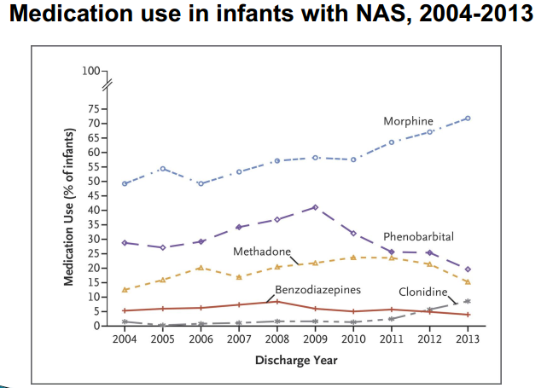

Medications
Tolia et al, NEJM, 2015;372: 2118-2126

Slide 49
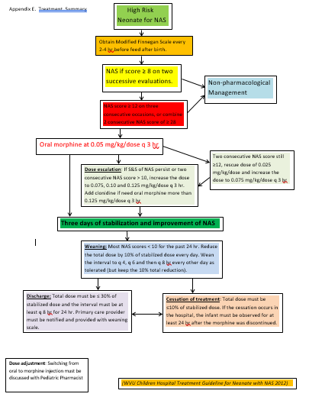
Algorithm

Slide 50
Initiation of Pharmacotherapy
3 consecutive scores ≥ 12
2 combined, consecutive scores ≥ 28

Slide 51
Morphine
Natural μ-opioid receptor agonist
Treats all aspects of opioid withdrawal
Oral preparation does not contain alcohol
Pitfalls
➢ Overdose/side effects may be severe
✓Apnea; sedation; constipation
➢ Treatment may last for several weeks
✓Difficult for caregivers to wean (psychologically)
➢ Exposes infant to more narcotics

Slide 52
Oral Morphine
Morphine 0.4 mg per mL oral solution
Initiation dose: 0.05 mg/kg every 3 hours
Monitor q12h: if scores ≥10, increase morphine in stepwise escalating doses
  0.075 mg/kg every 3 hours
  0.1 mg/kg every 3 hours
  0.125 mg/kg every 3 hours
  Add adjunctive agent

Slide 53
Clonidine
Analgesic; antihypertensive; ADHD therapy
α-adrenergic receptor agonist; activates inhibitory neuronal norepinephrine release & locks neuronal excitation in locus coeruleus
No over sedation; no lengthy taper; no alcohol
Pitfalls:
  Can cause hypotension and bradycardia
  Potential for 1000-fold error (μg vs. mg/mL)
  Abrupt discontinuation can lead to ⬆BP & HR, so must be weaned in the hospital

Slide 54
Clonidine Dosing
Clonidine 100 mcg per mL oral liquid
Initiation dose: 1 mcg/kg every 6 hours
If after 24 hours scores continue to be greater than 10 increase clonidine
  1.25 mcg/kg every 6 hours
  1.5 mcg/kg every 6 hours
  1.75 mcg/kg every 6 hours
  2 mcg/kg every 6 hours

Slide 55
Rescue Dosing
For intermittent periods of extreme symptoms or when increased dosing is needed
Rescue dose= 0.025 mg/kg once
Given if 2 scores > 12 while on therapy

Slide 56
Stabilization and Weaning
3 days of stabilization with consistent scores < 10
After stabilization, begin weaning pharmacotherapy

Slide 57
Weaning
Wean morphine 1st
  Reduce daily dose by 10% every 24 hours as long as scores are acceptable
  Alternate weaning dose or weaning interval
Begin clonidine wean once morphine is dosed at q8h interval or after morphine taper is complete
  Clonidine is weaned by reducing frequencies

Slide 58
Weaning Schedules
Stabilization Dose: 0.05 mg/kg every 3 hours
Step 1: 0.045 mg/kg every 3 hours
Step 2: 0.053 mg/kg every 4 hours
Step 3: 0.047 mg/kg every 4 hours
Step 4: 0.06 mg/kg every 6 hours
Step 5: 0.05 mg/kg every 6 hours
Step 6: 0.053 mg/kg every 8 hours
Step 7: 0.04 mg/kg every 8 hours (home going dose)
Step 8: 0.04 mg/kg every 12 hours (last inpatient step)
Step 9: 0.04 mg/kg every 24 hours
Notes:
example

Slide 59
Weaning Schedules
Clonidine (4mcg/kg/day)
Step 1: 1mcg/kg every 6 hours
Step 2: 1mcg/kg every 8 hours (home going dose)
Step 3: 1mcg/kg every 12 hours
Step 4: 0.5mcg/kg every 12 hours

Slide 60
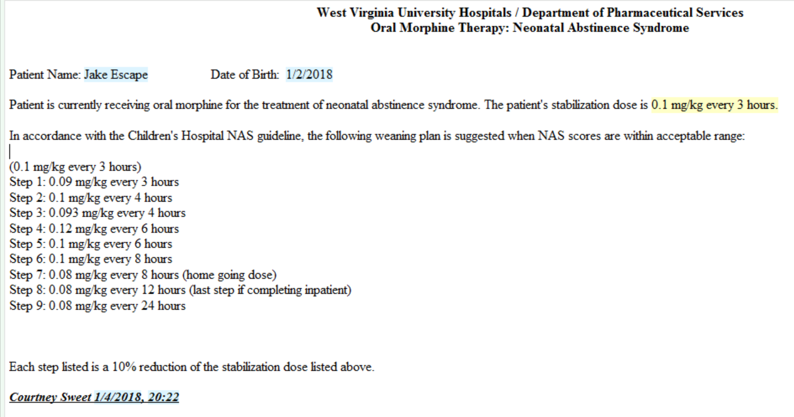
Pharmacy Note

Slide 61
Discharge Criteria
Select infants may be discharged to complete morphine taper at home
  Parents appropriate and involved during stay
  Mother is in recovery or doing well with treatment
  Foster care or Adoption cases
  Social work also discusses with CPS for their input
If patients complete taper inpatient
  Observed for 24 hours after last dose
  Weaning schedule is stopped at every 12 hour dosing

Slide 62
Home Morphine and Clonidine Weans
Morphine must be at 70% of stabilization daily dose
Prescription must be filled by our discharge pharmacy
  Individual oral syringes with doses
  Steps are bagged together to further help
Written instructions are provided to family and discharge counseling is conducted
Documented in discharge summary and after visit summary
Typically, weans are done slower (q 2-3 days) to allow families to adjust to being home

Slide 63
Outcomes and Lessons

Slide 64
Stigma
Care should be multidisciplinary, collaborative, nonjudgmental, and based on the identified needs of the infant–mother dyad so that care of the infant does not occur in isolation from the mother.
Creating a compassionate, safe environment for the mother is important, since many mothers feel stigmatized and guilty regarding substance use and the neonatal abstinence syndrome, which can lead to impaired communication with health care providers.
The mother’s participation in the care of her affected infant has the potential to benefit both mother and infant, with improvement in the manifestations of the syndrome and enhanced bonding and parenting
Patrick SW. The triple aim for neonatal abstinence syndrome. J Pediatr 2015; 167:1189-91

Slide 65
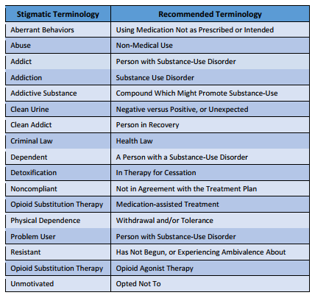
Stigma

Slide 66
Outcomes
ALL Treated Infants | 2013 (N=44) | 2014 (N=50) | 2015 (N=56) | 2016 (N=63) | 1st 5 months 2017 (N=24)
Average GA | 38 weeks | 37 weeks | 37 weeks | 38 weeks | 38 weeks
Outborn (%) | 55% | 48% | 61% | 41% | 46%
Phenobarbital Added | 2 patients | 2 patients | 7 patients | 3 patients | 2 PB 3 clonidine
Duration of Therapy | 15.3 days | 15.3 days | 15.9 days | 16 days | 14.6 days
Time prior to discharge | 2.4 days | 2.4 days | 1.9 days | 2.7 days | 1.5 days
Meds at discharge | 31.8% | 26% | 33.9% | 38% | 21%
Breast milk | 15.9% | 16% | 14.3% | 16% | 12.5%
Average NICU LOS | 16.9 days | 15.9 days | 16.3 days | 18.1 days | 13.5 days
Average LOS | 19.1 days | 19.7 days | 19.6 days | 19.9 days | 17.2 days
Median LOS | 18 days | 17 days | 18 days | 18 days | 16 days

Slide 67
Lessons Learned
Have a team/committee
Make minor changes as needed along the way
Communicate and celebrate success
Utilize all available resources
  Volunteer cuddlers
  Music therapist
  PT/OT therapist

Slide 68
Areas of Opportunity
Creating a culture that includes mothers as vital member of the medical team
  Scoring
  Treatment escalation and weaning
  Discharge planning
Cultivate an environment that encourages caregivers to be the primary therapeutic intervention (non-pharmacologic therapy)

Slide 69

Thank you

