Slide 1

Caring for the Substance Exposed Newborn from Birth and Beyond
M. Cody Smith, MD
Neonatology

Slide 2
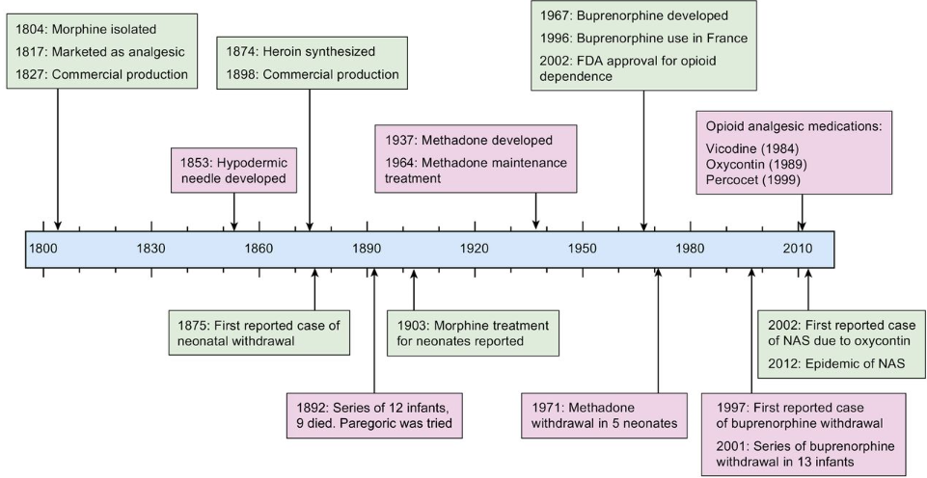
Historical Aspects

Slide 3



Slide 4
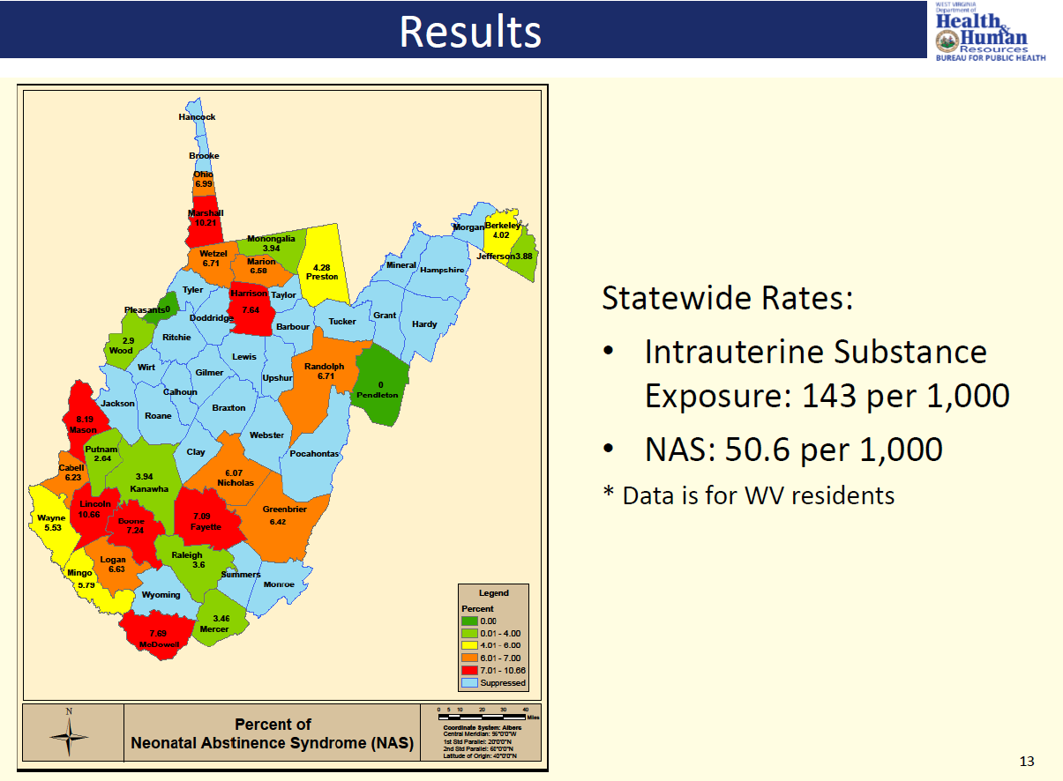
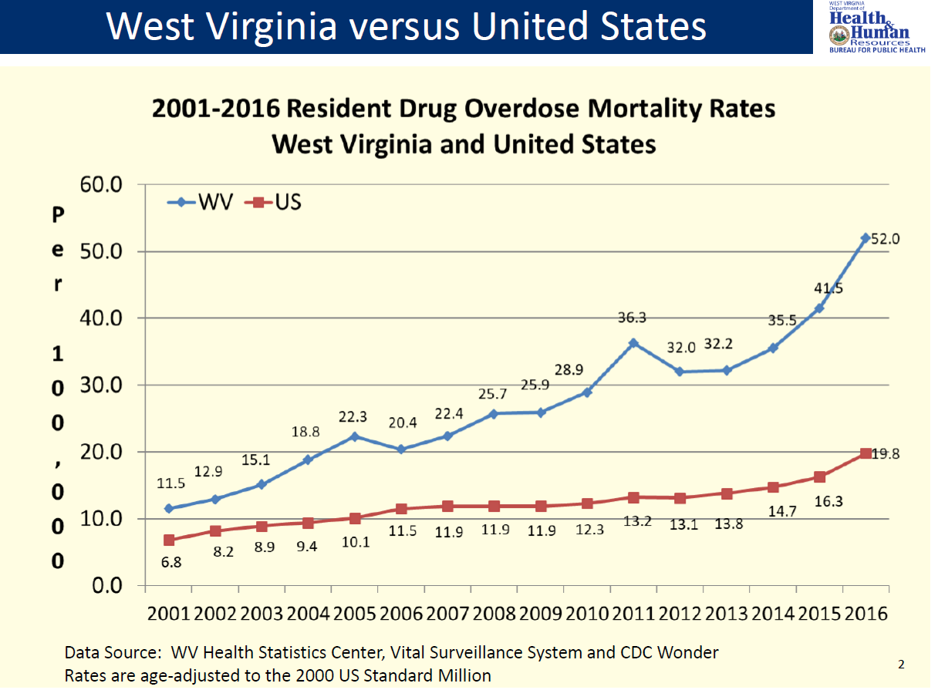

Slide 5

State Medicaid Programs Paying the Majority of the Cost
Cost is 15 to 16 times higher than healthy infants
Cost is rising –Mean hospital charges for discharges with NAS increased from $39,400 in 2000 to $53,400 in 2009
Patrick, S., Schumacher, R., Benneyworth, B., Krans, E., Mcallister, J., & Davis, M. (2013). Neonatal Abstinence Syndrome and Associated Health Care Expenditures. Obstetric Anesthesia Digest, 33(2), 86.
Roussos-Ross, K., Reisfield, G., Elliot, I., Dalton, S., & Gold, M. (2015). Opioid Use in Pregnant Women and the Increase in Neonatal Abstinence Syndrome. Journal of Addiction Medicine, 9(3), 222-225.

Slide 6
Definitions
Addiction
  A primary, chronic, neurobiological disease with genetic, psychosocial, and environmental factors that influence its development and manifestation
Physical dependence
  A state of adaptation that is manifested by a drug class-specific withdrawal syndrome
Neonatal abstinence syndrome
  A form of physical dependence resulting from in utero exposure to opioids, anxiolytics, antidepressants, antipsychotics, and other substances
  NOWS: Neonatal Opioid Withdrawal Syndrome

Slide 7
Neonatal Abstinence Syndrome (NAS)
Results from abrupt discontinuation of chronic fetal substance exposure used by the mother during pregnancy

Slide 8
Signs and Symptoms
Neurologic Signs
  Tremors; Jitteriness
  Seizures
  Irritability; Sleeplessness
  High-pitched cry
  Hypertonia; exaggerated
  Moro
  Yawning; sneezing
  Respiratory
  pauses/desaturations
Autonomic Instability
  Sweating
  Temperature Instability
  Fever
  Mottling
  Nasal Stuffiness
  Tachypnea
GI dysfunction
  Poor feeding
  Uncoordinated/constant sucking
  “Reflux”/Vomiting
  Diarrhea (leads to diaper rash; pain)
  Dehydration
  Poor weight gain

Slide 9
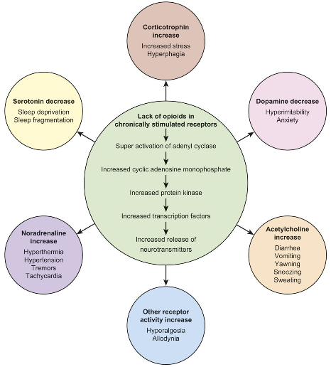
Mechanism of Opioid Withdrawal

Slide 10

Areas of Emphasis
Screening
Scoring
Non-pharmacologic
Pharmacologic
Followup
Outcomes

Slide 11

AAP Screening Recommendations
    Protocol for screening for maternal substance abuse.
    Standardized the evaluation and treatment of at risk infants.
    Begin NAS screening with a maternal history and physical examination.
Source: Mark L. Hudak, MD, Rosemarie C. Tan, MD,, PhD, THE COMMITTEE ON DRUGS, and THE COMMITTEE ON FETUS AND NEWBORN, American Academy of Pediatrics.

Slide 12
AAP Screening Recommendations
    Toxicological testing, as needed
    Multiple risk factors:
      maternal report or documentation of substance use
      late entry into care or no prenatal care
      previous unexplained late fetal demise
      precipitous labor
      placental abruption
    Observed substance exposed infants for 4-7.
Source: Mark L. Hudak, MD, Rosemarie C. Tan, MD,, PhD, THE COMMITTEE ON DRUGS, and THE COMMITTEE ON FETUS AND NEWBORN, American Academy of Pediatrics.

Slide 13
AAP Scoring Recommendations
Consider withdrawal in infants if signs develop.
Score by using a published abstinence assessment tool.
Substance exposed infants who are asymptomatic or have minimal signs of withdrawal do not require pharmacologic therapy.
Source: Mark L. Hudak, MD, Rosemarie C. Tan, MD,, PhD, THE COMMITTEE ON DRUGS, and THE COMMITTEE ON FETUS AND NEWBORN, American Academy of Pediatrics.

Slide 14
AAP Scoring Recommendations
Serial use of assessment tool may facilitate decisions for pharmacologic therapy and guide adjustments/ weaning.
Optimal threshold score for starting pharmacologic therapy is unknown.
Source: Mark L. Hudak, MD, Rosemarie C. Tan, MD,, PhD, THE COMMITTEE ON DRUGS, and THE COMMITTEE ON FETUS AND NEWBORN, American Academy of Pediatrics.

Slide 15
NAS Scoring Scales
Finnegan Neonatal Abstinence Scoring Tool (1975)
  31 items
Modified Finnegan Scoring System (1986)
  21 of the original items
  Reorganized into 3 categories
Lipsitz Neonatal Drug- Withdrawal Scoring System
  11 items
Neonatal Withdrawal Inventory
Neonatal Narcotic Withdrawal Index
Notes:
Original Finnegan and Lipsitz tools were published in 1975.
The modified finnegan in 1986

Slide 16
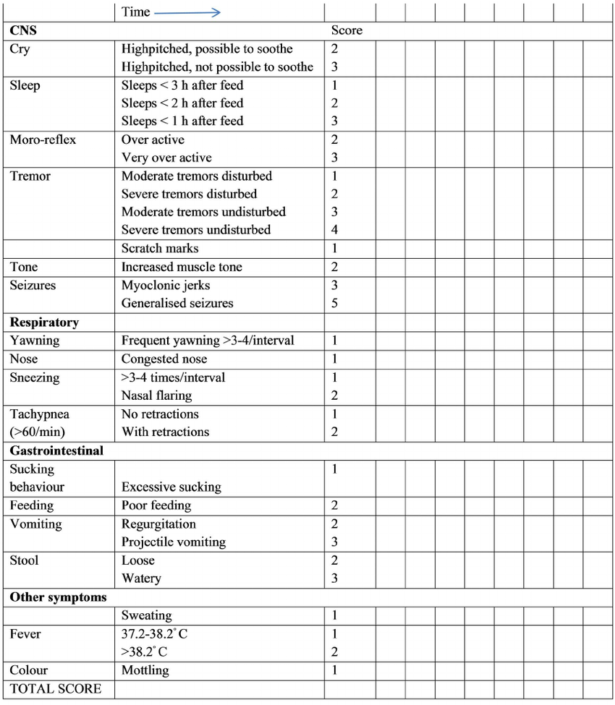
Modified Finnegan Scoring System
Hudak M L et al. Pediatrics 2012;129:e540-e560

Slide 17
Challenges for Consistency in Scoring
Even though consistent training of staff to utilize assessment tools can increase interrater reliability, scoring with caregivers still remains subjective
(Wiles, Ward, & Akinbi, 2014).

Slide 18
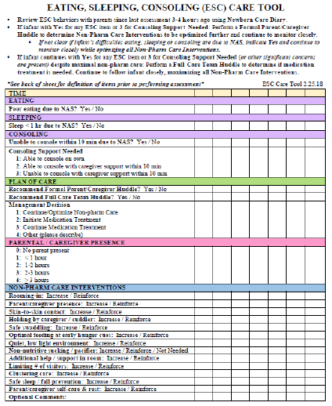
The “Eat, Sleep, Console” (ESC) Assessment Tool and Training Materials are copyrighted by Boston Medical Center Corporation, Dr. Matthew Grossman, Mary Hitchcock Memorial Hospital, Dartmouth-Hitchcock Clinic (2017).

Slide 19
AAP Treatment Recommendations
Initial approach: Nonpharmacologic supportive measures (minimizing environmental stimuli, promoting adequate rest and sleep, and providing sufficient caloric intake).
Encourage breastfeeding and the provision of expressed human milk if not contraindicated.
Source: Mark L. Hudak, MD, Rosemarie C. Tan, MD,, PhD, THE COMMITTEE ON DRUGS, and THE COMMITTEE ON FETUS AND NEWBORN, American Academy of Pediatrics.

Slide 20
Evidenced Based
Nonpharmacologic Care
Several interventions have proven to be effective in managing NAS and should be incorporated into standard of care for this population:
  breastfeeding, swaddling, rooming-in, environmental control and skin to skin contact
Source: Ryan, G. et al. Nonpharmacological management of neonatal abstinence syndrome: a review of the literature. J Matern Fetal Neonatal Med. 2019 May;32(10):1735-1740.

Slide 21
AAP Treatment Recommendations
Second approach: pharmacotherapy
Caution: pharmacologic therapy could lengthen the duration of hospitalization and interfere with maternal-infant bonding.
Source: Mark L. Hudak, MD, Rosemarie C. Tan, MD,, PhD, THE COMMITTEE ON DRUGS, and THE COMMITTEE ON FETUS AND NEWBORN, American Academy of Pediatrics.

Slide 22
AAP Treatment Recommendations
Pharmacologic therapy for withdrawal-associated seizures is indicated.
Vomiting, diarrhea, or both associated with dehydration and poor weight gain are relative indications for treatment.
Source: Mark L. Hudak, MD, Rosemarie C. Tan, MD,, PhD, THE COMMITTEE ON DRUGS, and THE COMMITTEE ON FETUS AND NEWBORN, American Academy of Pediatrics.

Slide 23
High Calorie Formula
Early initiation of high-calorie formula for infants with prenatal methadone exposure may be beneficial for weight gain
? low lactose
Hospital Pediatrics 2018;8;7 Methadone-Exposed Infants: A Feasibility Study Randomized Clinical Trial of Standard- Versus High-Calorie Formula for

Slide 24
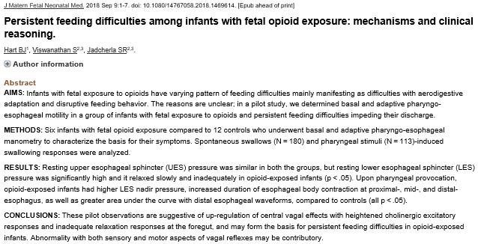
Feeding Difficulties

Slide 25
Feeding Difficulties
Per Dr. Jadcherla, “While feeding, the bolus doesn’t move efficiently, because of [increased] resistance,”
“We now know it’s not reflux so we don’t treat it with acid-suppressive medication,”
“Acid is needed for good digestion of milk. If acid’s suppressed, you create a new problem.”

Slide 26
AAP Treatment Recommendations
Oral morphine solution and methadone when pharmacologic treatment is indicated.
Oral clonidine is also effective either as a primary or adjunctive therapy, but further trials needed.
Source: Mark L. Hudak, MD, Rosemarie C. Tan, MD,, PhD, THE COMMITTEE ON DRUGS, and THE COMMITTEE ON FETUS AND NEWBORN, American Academy of Pediatrics.

Slide 27
AAP Treatment Recommendations
Buprenorphine for the treatment of NAS require additional study.
Optimal pharmacologic treatment of infants who are withdrawing from sedatives or hypnotics is unknown.
Insufficient evidence as to whether polysubstance exposed infants is best treated with an opioid, a barbiturate, a medication from another drug class, or a combination of drugs from different classes.
Source: Mark L. Hudak, MD, Rosemarie C. Tan, MD,, PhD, THE COMMITTEE ON DRUGS, and THE COMMITTEE ON FETUS AND NEWBORN, American Academy of Pediatrics.

Slide 28
Outpatient Pharmacotherapy
Outpatient pharmacotherapy for NAS was associated with higher length of therapy and higher rates of ED utilization when compared with infants treated exclusively as inpatients.
Source: J Pediatr. Maalouf F. Outpatient Pharmacotherapy for Neonatal Abstinence Syndrome. 2018 Aug;199:151-157. jpeds. 2018. Epub 2018 May 10.

Slide 29
AAP Discharge Follow-up
Recommendations
Outpatient follow-up should occur early and include reinforcement of the education of the caregiver about the risk of late withdrawal signs.
Source: Mark L. Hudak, MD, Rosemarie C. Tan, MD,, PhD, THE COMMITTEE ON DRUGS, and THE COMMITTEE ON FETUS AND NEWBORN, American Academy of Pediatrics.

Slide 30
Safe Sleep:
Back to sleep for every sleep
To reduce the risk of SIDS, infants should be placed for sleep in a supine position for every sleep by every caregiver until 1 year of age.
Side sleeping is not safe and is not advised.
Notes:
Prone positioning is acceptable if the infant is observed and awake, particularly in the postprandial period, but prone positioning during sleep can only be considered in infants with certain upper airway disorders in which the risk of death from GERD may outweigh the risk of SIDS” (type 3 or 4 laryngeal clefts, who have not undergone antireflux surgery).

Slide 31
Safe Sleep:
Back to sleep for every sleep
Supine sleep position does not increase the risk of choking and aspiration in infants, even those with gastroesophageal reflux, because infants have airway anatomy and mechanisms that protect against aspiration.
Notes:
Prone positioning is acceptable if the infant is observed and awake, particularly in the postprandial period, but prone positioning during sleep can only be considered in infants with certain upper airway disorders in which the risk of death from GERD may outweigh the risk of SIDS” (type 3 or 4 laryngeal clefts, who have not undergone antireflux surgery).

Slide 32
Safe Sleep:
Back to sleep for every sleep
Elevating the head of bed is ineffective in reducing gastroesophageal reflux and is not recommended
  May result in the infant sliding to the foot of the crib into a position that may compromise respiration.
Many infants are smoke exposed as well…
  Both maternal smoking during pregnancy and smoke in the infant’s environment after birth are major risk factors for SIDS.
Notes:
Prone positioning is acceptable if the infant is observed and awake, particularly in the postprandial period, but prone positioning during sleep can only be considered in infants with certain upper airway disorders in which the risk of death from GERD may outweigh the risk of SIDS” (type 3 or 4 laryngeal clefts, who have not undergone antireflux surgery).

Slide 33
Outcomes
Severity of withdrawal signs, including seizures, has not been proven to be associated with differences in long-term outcome after intrauterine drug exposure.
Treatment of drug withdrawal may not alter the long-term outcome.
Source: Mark L. Hudak, MD, Rosemarie C. Tan, MD,, PhD, THE COMMITTEE ON DRUGS, and THE COMMITTEE ON FETUS AND NEWBORN, American Academy of Pediatrics.

Slide 34
Outcomes
Lack of evidence on the long-term effects of prenatal opioid exposure.
Long-term outcome of infants with NAS is unknown
  infants were embedded within more general studies of infants with in utero opioid exposure
  most studies followed infants for only a few years.
Source: Reddy, U et al. Opioid Use in Pregnancy, Neonatal Abstinence Syndrome, and Childhood Outcomes: Executive Summary of a Joint Workshop by the Eunice Kennedy Shriver National Institute of Child Health and Human Development, American Congress of Obstetricians and Gynecologists, American Academy of Pediatrics, Society for Maternal-Fetal Medicine, Centers for Disease Control and Prevention, and the March of Dimes Foundation. Obstet Gynecol. 2017 July ; 130(1): 10–28.
Notes:
Most studies were conducted prior to the start of the current opioid epidemic and have not included addiction related to prescription drug use.

Slide 35
Outcomes
Findings from the follow-up literature on infants with prenatal opioid exposure are inconsistent.
  Small sample sizes
  Multiple confounding factors (polydrug use, environmental exposures, and poverty) not controlled for
  Poor retention rates
  No/inappropriate comparison group.
Preventive interventions that focus on enriching the early experiences of such children and improving the quality of the home environment are likely to be beneficial.
Source: Reddy, U et al. Opioid Use in Pregnancy, Neonatal Abstinence Syndrome, and Childhood Outcomes: Executive Summary of a Joint Workshop by the Eunice Kennedy Shriver National Institute of Child Health and Human Development, American Congress of Obstetricians and Gynecologists, American Academy of Pediatrics, Society for Maternal-Fetal Medicine, Centers for Disease Control and Prevention, and the March of Dimes Foundation. Obstet Gynecol. 2017 July ; 130(1): 10–28.
Notes:
Most studies were conducted prior to the start of the current opioid epidemic and have not included addiction related to prescription drug use.

Slide 36
Outcomes
Chronic opiate use in pregnancy appears to increase the risk for a head circumference ≤ 10th percentile and ≤ 3rd percentile.
Femur and humerus lengths appear to be shortened suggesting a possible effect on bone growth.
Chronic Opiate Use in Pregnancy and Newborn Head Circumference. American Journal of Perinatology 2015; 01: 027-032

Slide 37
Outcomes
Infants with subclinical opioid exposures more likely to be diagnosed with:
  behavioral or emotional disorders (3.0% vs 1.1%)
  developmental delay (15.6% vs 7.6%)
  speech disorder (10.1% vs 6.5%)
  strabismus (3.4% vs 1.0%)
  hepatitis C virus exposure (6.8% vs 0.1%).
Hall ES. Developmental Disorders and Medical Complications Among Infants with Subclinical Intrauterine Opioid Exposures. Popul Health Manag. 2019 Feb;22(1):19-24. Epub 2018 Jun 12.

Slide 38
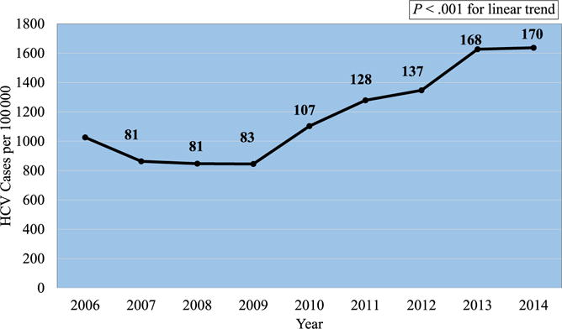
Outcomes
Despite the increased HCV prevalence among pregnant women and the risk of perinatal HCV transmission, HCV-exposed infants are not adequately screened, and many pediatric HCV infections remain undetected.
Chappell CA, et al. Hepatitis C Virus Screening Among Children Exposed During Pregnancy. Pediatrics. 2018 Jun;141(6). Epub 2018 May 2.

Slide 39
Outcomes
A neonatal diagnostic code of NAS is strongly associated with poor and deteriorating school performance.
Oei JL. Pediatrics. Neonatal Abstinence Syndrome and High School Performance. February 2017, VOLUME 139 / ISSUE 2

Slide 40
Outcomes
Children who lived with foster/adoptive families at follow up had higher cognitive scores than those who lived with biological relatives, especially motor scores.
8% of children required treatment for strabismus.
Merhar, S. L., McAllister, J. M., Wedig-Stevie, K. E., Klein, A. C., Meinzen-Derr, J., & Poindexter, B. B. (2018). Retrospective review of neurodevelopmental outcomes in infants treated for neonatal abstinence syndrome. Journal of Perinatology, 38(5), 587–592. https://doi.org/10.1038/s41372-018-0088-9

Slide 41
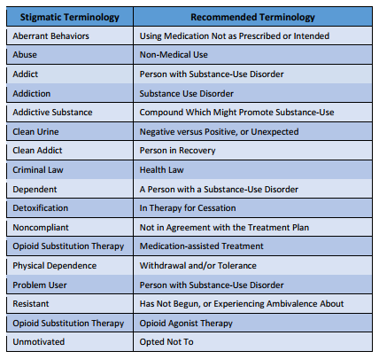
Stigma
Mothers feel stigmatized and guilty regarding substance use and NAS, leading to impaired communication providers.
Multidisciplinary, collaborative, nonjudgmental care so that the infant’s care does not occur in isolation from the mother.
Mother’s participation in the care has the potential to benefit the dyad, with improvement in symptoms, bonding, and parenting.
Patrick SW. The triple aim for neonatal abstinence syndrome. J Pediatr 2015; 167:1189-91
Notes:
Deconditioned / Compassion fatigue

Slide 42

Thank You
mcsmith@hsc.wvu.edu

