Slide 1

Current status
Marsha Quinn
Executive Director
Notes:
1

Slide 2
agenda
Tell you more about P2P USA and our current status
Talk about two of our strategic priorities and get your input
Strengthen our understanding of Parent to Parent peer support and its evidence-informed practices.
Reflect on how our own stories shape the way we support other families.
Practice a simple self-care strategy that can be used during emotionally demanding work.
Explore the diverse families and communities we want to reach more intentionally.
Identify training topics, tools and resources that Parent to Parent USA could offer nationally.

Slide 3
Today’s Learning Goals
Strengthen our understanding of Parent to Parent peer support and its evidence-informed practices.
Take a deep dive into peer support research and why what we do is so important.
Identify training topics, tools and resources that Parent to Parent USA could offer nationally.
Explore the diverse families and communities we want to reach more intentionally.
Reflect on how our own stories shape the way we support other families.
Practice a simple self-care strategy that can be used during emotionally demanding work.

Slide 4
OUR MISSION
Support a national network of Parent to Parent
programs to ensure access to quality,
emotional support for families of
individuals with disabilities and/or
special health care needs.
No parent should feel alone. Ever.

Slide 5
The Power of Parent-to-Parent Connection
A parent who has 'been there' can offer something professionals often cannot: lived experience.
Peer support can reduce isolation, create hope, validate emotions and help families see possibilities.
Our goal is not to fix a family's situation—it is to walk alongside them.
The relationship matters: listening, trust, shared experience and respect are foundational.

Slide 6
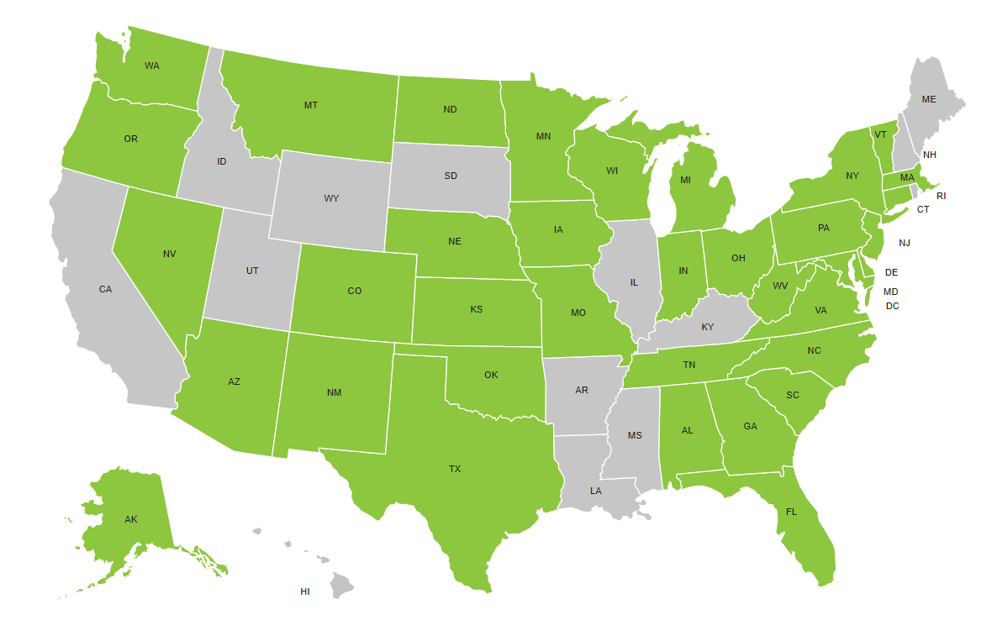
37 Alliance Members

Slide 7
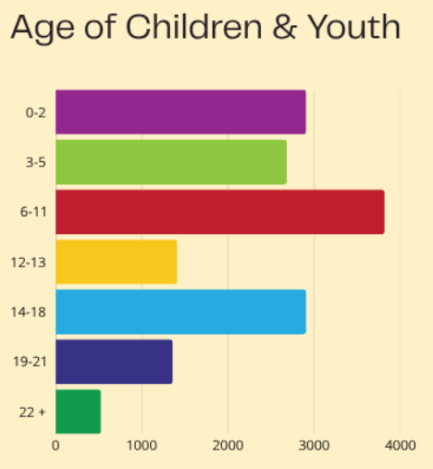
2025 impact report

Slide 8
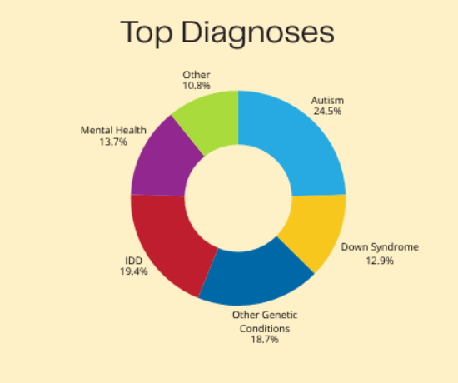


2025 impact report

Slide 9
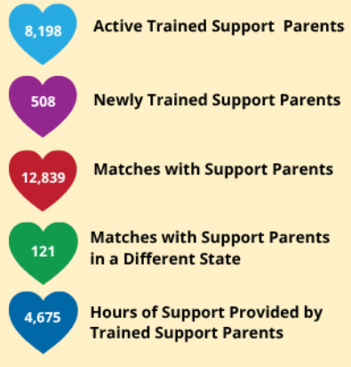
2025 impact report

Slide 10
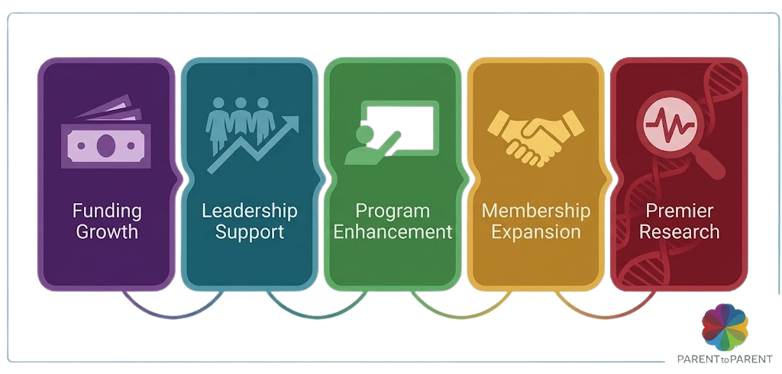
OUR STRATEGIC OBJECTIVES

Slide 11

Premier Research
Leading the Research Agenda
Establishing Parent to Parent USA as the premier national source for peer support evidence, research, and data-driven insights.
Refreshing Impact Evaluation: Updating ongoing research to measure long-term family outcomes and wellbeing metrics.
Academic Partnerships: Collaborating with leading research bodies (such as the American Institutes for Research) to validate models.
Data-Driven Innovation: Utilizing quantitative and qualitative insights to continuously shape best practices for peer matching.

Slide 12

EVIDENCE-BASED PEER SUPPORT PRACTICES
    Contact referred parent within 24-48 hours.
    Match referred parent to support parent.
    Follow up within 1 week.
    4 contacts within 8 weeks.
    Evaluate after 8 weeks.

Slide 13
What the Research Can Teach Us
Peer support is increasingly recognized as a meaningful component of family-centered support.
Research and practice point to benefits such as reduced isolation, increased confidence and connection to information and resources.
Parent-to-parent relationships can help families navigate complex systems while feeling understood by someone who has lived a similar experience.
A key opportunity for P2P USA: strengthen the evidence base around what makes a 'meaningful contact' and what outcomes families experience.
Discussion: What outcomes do you see that we should be measuring?
Notes:
What does a meaningful contact mean to you?

Slide 14
Research Questions for Parent to Parent USA
What makes a Parent-to-Parent match successful?
Which practices are most helpful during the first contact and over time?
How does peer support affect caregiver isolation, confidence and navigation of systems?
What differences do we see across family populations and settings?
How can we collect meaningful data without making families feel like research subjects? (Not currently doing this directly at the national level).
Notes:
What is working for you and what isn’t? Is there a particular situation or scenario that sticks out where you were super frustrated, or better yet, feeling really positive about?

Slide 15

Program enhancement
Elevating Alliance Program Quality
Scaling core peer-support tools, standardized training protocols, and choice boards across all 37 Alliance Member programs.
Standardized Training & Choice Boards: Equipping state coordinators and volunteer Support Parents with updated training modules and accessible resources.
24–48 Hour Matching Protocol: Refining national referral workflows to guarantee referred parents receive 1-on-1 peer matching within 24–48 hours.
Technical Assistance & Capacity: Providing operational assistance, tools, and digital infrastructure to expand regional program sustainability.

Slide 16
If You Could Have More Training…
What additional skills would you want to learn?
What skills would make your Support Parent role easier or more meaningful?
What situations do you encounter that you do not feel fully prepared for?
What resources could P2P USA develop once and make available nationally?
Notes:
Are there situations where you’re not quite sure what to do or what to say? How do you problem solve with the family? We creating role playing videos on difficult conversations, what to say and what not to say, boundaries, expectations of a volunteer Support Parent and will be sending them to AM in early 2027.

Slide 17
Imagine a National P2P Training Menu
Advanced listening and relationship-building
Difficult conversations and setting boundaries
Crisis situations and knowing when to refer
Telling your story effectively and safely
Self-care, resilience and avoiding burnout
Engaging fathers and male caregivers
Supporting Spanish-speaking families
Rural outreach and virtual peer support
Foster and kinship family support
Substance exposure and family-centered peer support
Transitions and systems navigation
Cultural humility and working across differences
Notes:
This is my wish list. Can you help add to this list? What do you envision as a great training to help you support other families….OR support you?

Slide 18
Who Are We Trying to Reach?
Fathers and male caregivers
Spanish-speaking families and families who prefer support in Spanish
Rural and geographically isolated families
Families navigating substance exposure and related systems
Foster families
Kinship caregivers
Siblings

Slide 19
Fathers & Male Caregivers
How can we create more natural entry points for fathers and male caregivers?
What makes peer support feel relevant, accessible and comfortable?
What voices and stories are missing from our current network?
What training would help Support Parents better engage fathers?

Slide 20
Spanish-Speaking Families
Language access is more than translation—it includes trust, cultural context and meaningful connection.
How can P2P programs build stronger pathways to Spanish-speaking families?
What resources, training or outreach tools would help Alliance Members?
What would a strong national Spanish-language peer-support strategy look like?

Slide 21
Rural Families
Geographic distance can increase isolation and make services harder to access.
Virtual peer support can create connection across distance.
Local knowledge and trusted community relationships remain essential.
What would help rural families find a Support Parent quickly and reliably?

Slide 22
Foster, Kinship & Families Experiencing Substance Exposure
Families may be navigating multiple systems at once: child welfare, health care, education, behavioral health and community services.
Peer support can offer understanding without judgment.
Training may need to address trauma, boundaries, confidentiality, mandated reporting and complex family dynamics.
What does a Support Parent need to know—and what should remain outside the Support Parent role?

Slide 23
Share Back: What Should P2P USA Build?
One training topic we should prioritize
One audience we should better serve
One tool/resource that would make a difference
One research question we should pursue
One thing that would strengthen your confidence as a Support Parent

Slide 24
Activity: Tell Your Story
Think of one experience that shaped the way you show up for families.
What happened? What did you need at that moment?
Who—or what—helped you feel less alone?
What did you learn that you now carry into your peer-support role?
Choose what you are comfortable sharing. You are always in control of your story.

Slide 25
Activity: Tell Your Story
The first few months of your journey - what age your child got diagnosed, the diagnosis, give details on where you were and who was in your initial support system.
How the experience of having a child with a disability or special needs changed your family.
A time when you had a moment of joy.
Who was your biggest supporter?

Slide 26
Using Our Stories with Intention
Our stories can build connection—but the family's story must remain at the center.
Share enough to create connection, not so much that the conversation becomes about us.
Avoid assumptions: similar experiences do not mean identical experiences.
Ask permission before offering a personal example or resource.
Use lived experience to create hope, not prescribe a path.

Slide 27
Activity: Self-Care Check-In
Pause. Put both feet on the floor and take three slow breaths.
Notice: What am I carrying right now?
Name: What is one thing within my control today?
Choose: What is one small action that would help me feel supported or restored?
Commit: What is one boundary, practice or connection I can protect this week?
Notes:
Now I am talking to you as a parent…a volunteer…someone who has their own day to day life experiences with their family who has chosen to help another in a similar situation.

Slide 28
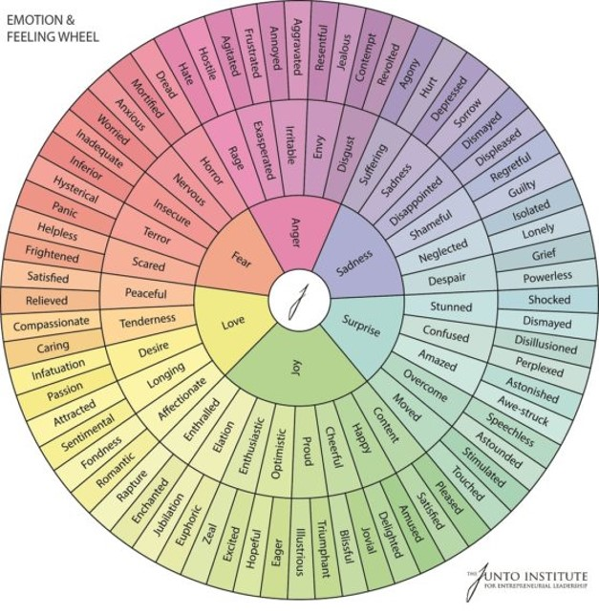
Activity: Self-Care Check-In
Notes:
Now I am talking to you as a parent…a volunteer…someone who has their own day to day life experiences with their family who has chosen to help another in a similar situation.

Slide 29
Self-Care Is Part of the Work
Peer support can be emotionally rewarding—and emotionally demanding.
Self-care is not simply 'taking a break'; it also includes boundaries, connection, supervision, reflection and knowing when to step back.
Healthy peer support protects both the family seeking support and the person providing it.
Question: What helps you stay present without carrying the family's experience home with you?
Notes:
Were any of you able to take a run at the Self Care Assessment that Ali sent out?

Slide 30
Closing Reflection:
One Word + One Wish
One word: How are you leaving this conversation?
One wish: What do you hope Parent to Parent USA will make possible for families and Support Parents in the next few years?
One action: What is one thing you can carry forward from today?

Slide 31
Thank You — Your Stories Are Part of the Network
Your lived experience is a strength.
Your connection can help another parent feel less alone.
Your ideas can help shape the next generation of Parent to Parent training.
No parent should feel alone. Ever.
P2PUSA.ORG

Slide 32
Support Parent summit
October 14, 2026
12n- 4p EST
Notes:
10

Slide 33

CONTACT US
Marsha Quinn
mquinn@p2pusa.org
Theresa Maier
tmaier@p2pusa.org
P2PUSA.ORG
Notes:
10

